Slide 1
Safeguarding at
Intake Farm
Parents’ information evening February 2024

Slide 2
Safeguarding at Intake Farm
Intake Farm - committed to creating a happy and safe environment for our children to learn.
The following slides show how we keep your children safe by explaining:
• Some of the different ways children can be harmed.
• How we can work together to keep our children safe from harm.
• Steps you can take to keep your child safe from harm.

Slide 3
Safeguarding and child protection
Child Protection: an important subject in which all staff receive regular training.
Our priority is to work with you but there may be times when we have to involve other people.
Everybody has a responsibility to keep all children safe.
We have a statutory responsibility to share any concerns we might have about a child in need of protection with other agencies, in particular children’s social care.
Schools are not able to investigate concerns but have a legal duty to refer them.

Slide 4
Abuse and harm
Abuse/harm is identified in four ways:
Physical — when a child is deliberately hurt or injured.
Sexual — when a child is influenced or forced to take part in a sexual activity. This can
be a physical activity or non-physical, e.g. being made to look at an inappropriate image.
Emotional — when a child is made to feel frightened, worthless or unloved. It can be
by shouting, using threats or making fun of someone. It can also be when children see
their parents/carers, or visitors to the home, fighting or using violence.
Neglect — when a child is not being taken care of by their parents/carers. It can be
poor hygiene, poor diet, not keeping appointments for additional support, not coming
to school, or being left home alone.
It is advised that ALL parents/carers are familiar with our Safeguarding Policy which is available through our website and on request.

Slide 5
How we keep children safe
A child should be able to go to school and feel safe so that they can achieve their very best.
We will ensure:
All staff are DBS checked and trained on how we safeguard.
The school has 3 Designated Safeguarding Leads: J Fieldwick, H Cox, L Jackson. They have extra training to know what to do when a concern is brought to them.
We always listen to you and work closely with you if we are concerned about your child but, sometimes, we may not be able to discuss our concern. The school has a safeguarding policy which tells you more about this and when we must speak to children’s social care.
Our PSHE and IT curriculum helps children learn how to keep safe. Lessons include healthy eating, anti‐bullying, e‐safety, road safety, healthy relationships, drug and alcohol awareness.
As part of these lessons and assemblies, your child will be told what to do if they are worried or concerned about their safety.

Slide 6
Keeping your child safe online
Listed below are various apps that are very popular with children.
People who could pose a risk to our children are known to use apps that have chat rooms or messaging features to access and groom children.

Slide 7
Keeping your child safe online
Below is a comprehensive but not exhaustive list of apps that are currently very popular with children. The ones highlighted red are not suitable for children of primary age. We wish to make you aware of the possible dangers posed by underage children using these sites.
The messaging services also make it very easy for online bullying to take place, and this can have devastating consequences.
It is a massive job trying to keep up with trends that children follow. The most popular apps can change frequently.
An up-to-date place for advice is https://nationalcollege.com/parents

Slide 8
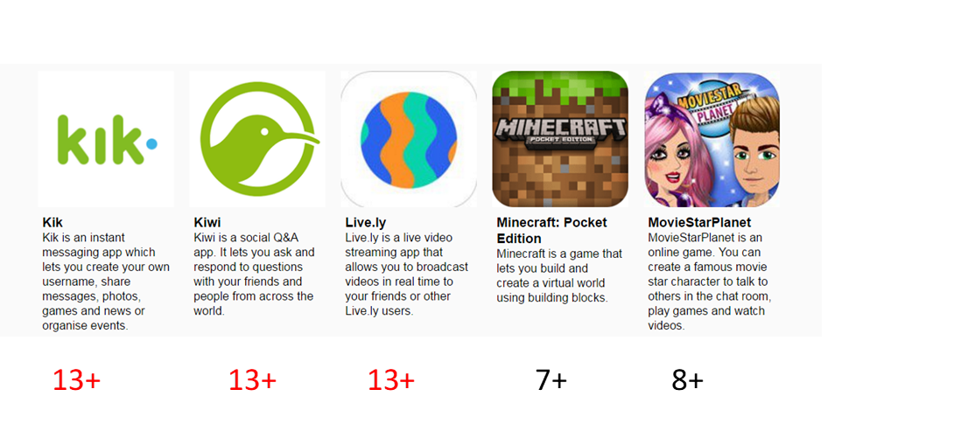
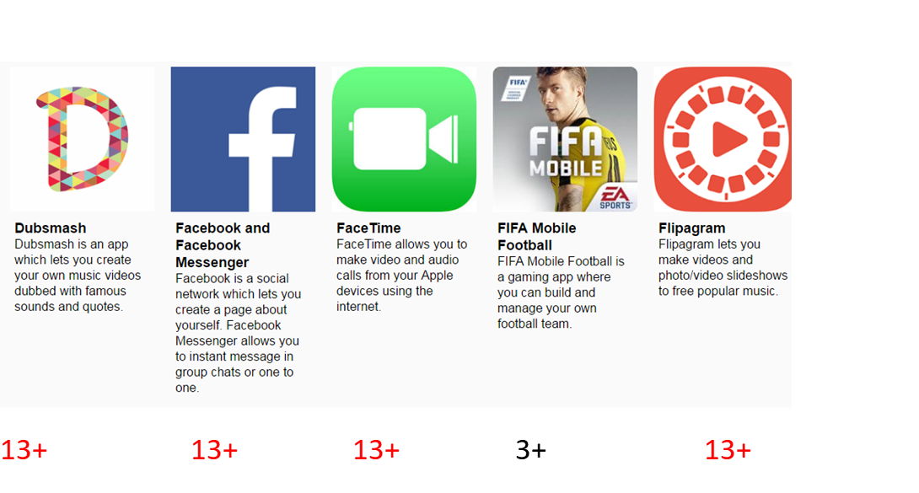
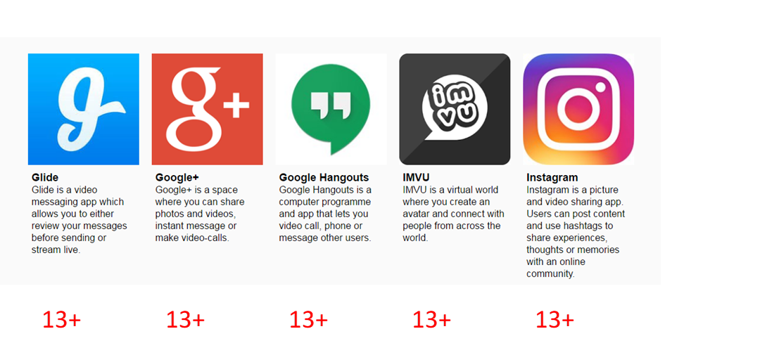
Apps

Slide 9
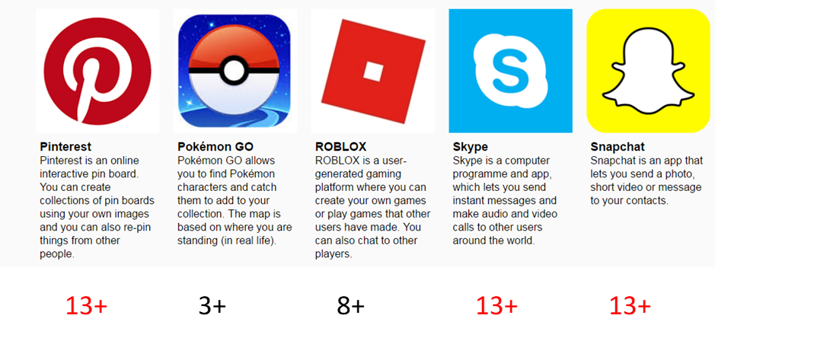
Apps

Slide 10
What parents and carers must do
Parents/carers are the most important people to keep their children safe. You should always:
Feel confident to raise concerns about your child.
Talk to school if you need help or support.
Read the school safeguarding policy available on request and on the school’s website.
Let the school know if your child has a medical condition.
Let the school know if you have any court orders relating to the safety of your child.
Let the school know if there is a change in your circumstances such as a house move, a new contact number, a change of name, a change of parental responsibility.
Let the school know who will be dropping off or collecting your child and provide us with contact names and numbers.
Let the school know if your child is going to be absent and the reasons why.

Slide 11
Safeguarding issues
Attendance - Your child's attendance is monitored daily and significant absences are always followed up by the attendance officer. The school has an attendance policy that you should read and understand.
Behaviour – Intake Farm has clear behaviour rules for the whole school community that must be followed to keep everyone safe and happy. We understand that children sometimes fall out and this will be dealt with by an adult who will listen to the children involved and help resolve the situation.
Bullying - The school takes all cases of bullying very seriously and will work with children and families to try and resolve any problems. The school has an anti-bullying policy that you should read and understand.

Slide 12
Safeguarding issues
Health and Safety - Everyone at Intake Farm has a responsibility to keep adults and children safe within the school environment. The school has a clear health and safety policy which everyone must follow. The school have fully trained first aiders to deal with any accidents in school.
E‐safety – We recognise that technology plays an important role in the education of our children. We are committed to safeguarding children in the virtual world. Parents/carers should be vigilant and ensure that their children are accessing age-appropriate social media platforms and games.

Slide 13
Complaints
Complaints - If you have any complaints about how the school is working with you or your child please feel confident to speak to us. I will always be happy to speak to you to resolve any difficulties. It is better to speak to us as soon as you have a concern so that it does not become a bigger issue. If you do not feel the matter has been resolved, you can raise your concerns with the Chair of Governors.

Slide 14
Websites for advice
NSPCC https://learning.nspcc.org.uk/research-resources/leaflets/parent-leaflets

