Slide 1
Our learning environment #6
February 2023

Slide 2
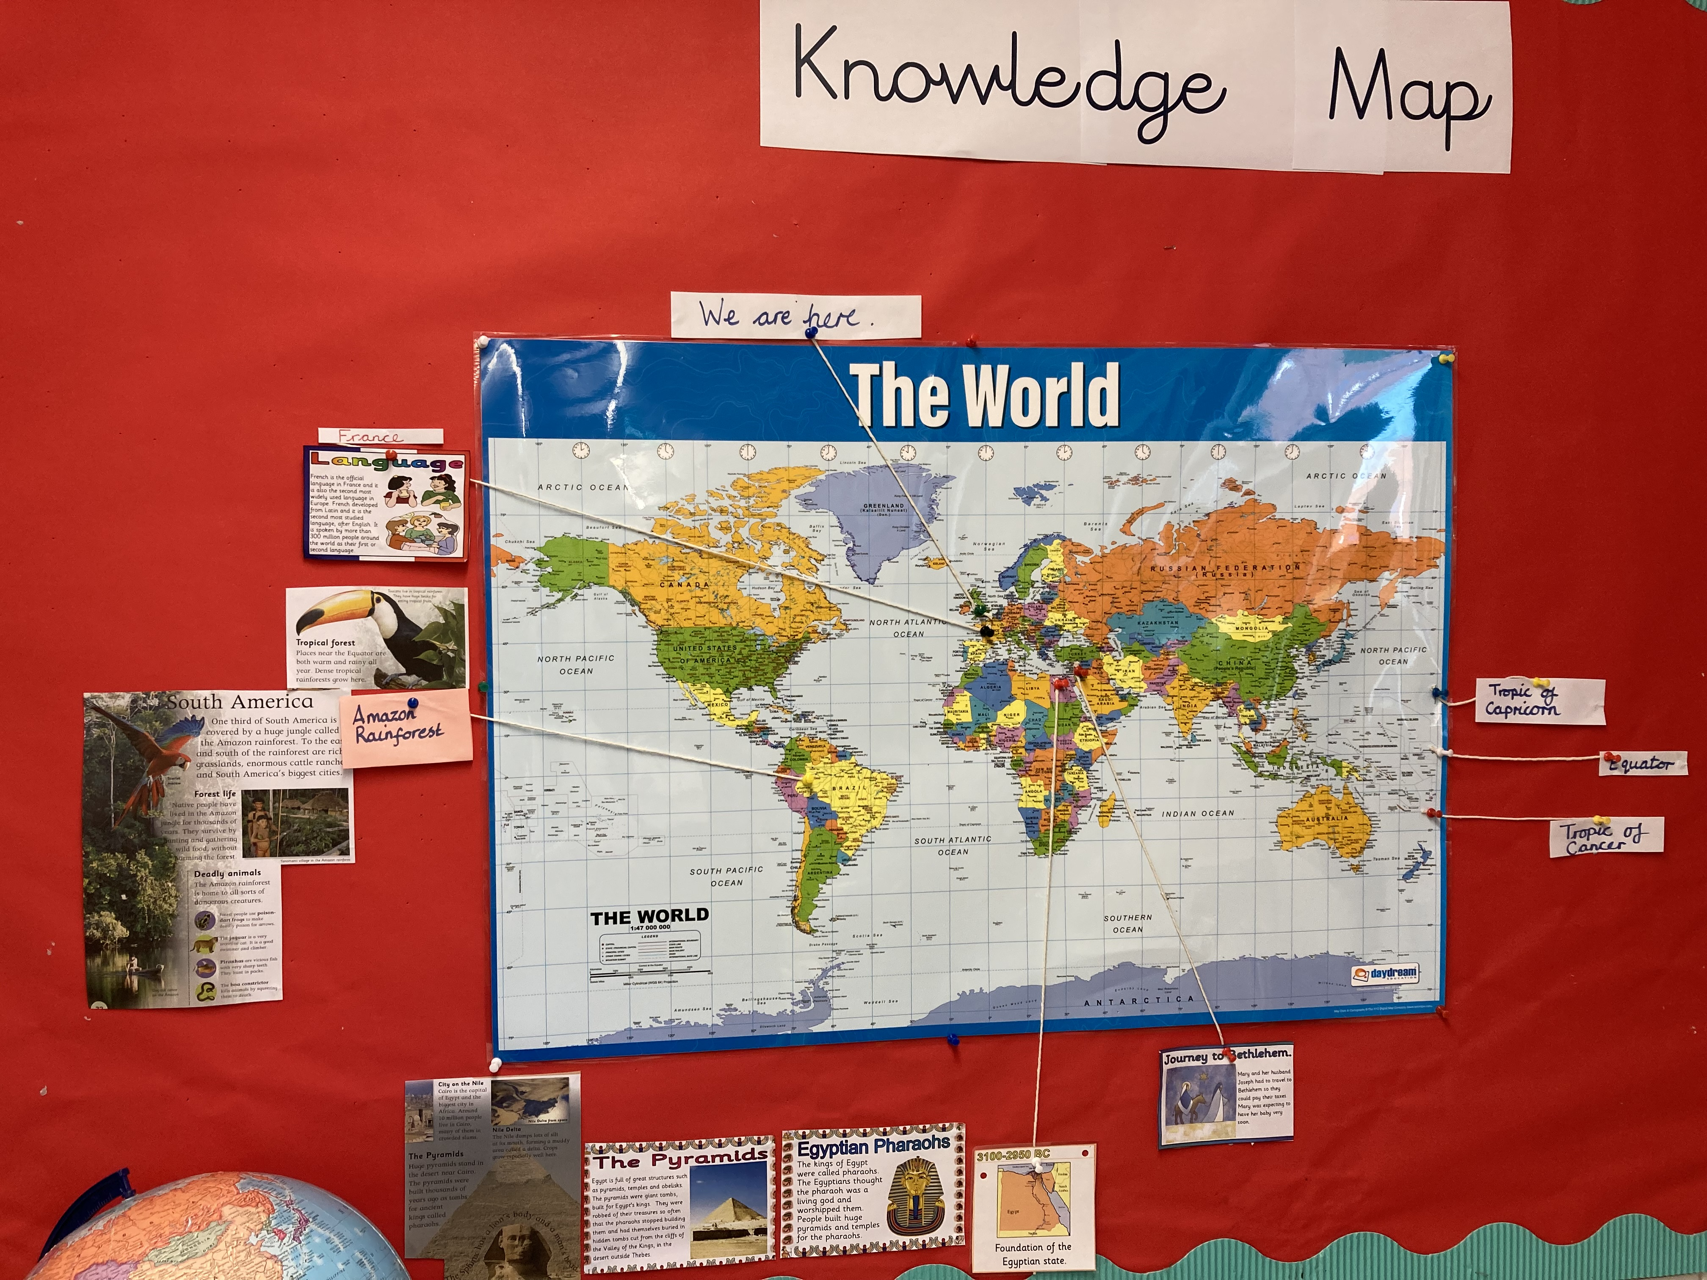
Y3’s knowledge map is used and added to all the time.

Slide 3
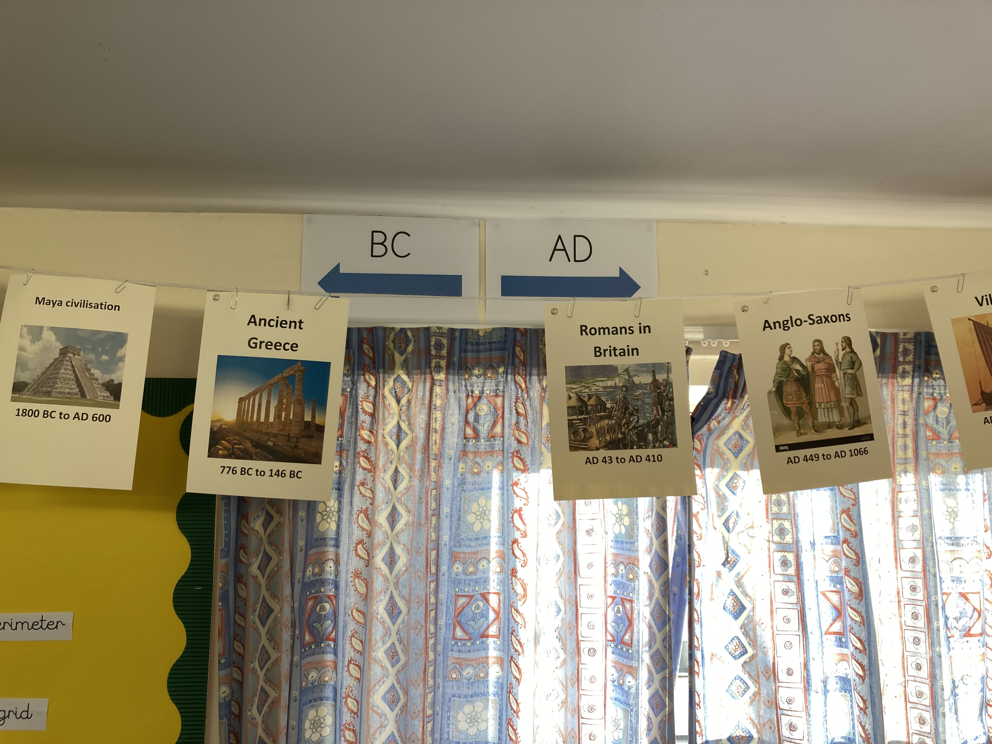
The whole school timeline is in every class. It runs through history from the
Stone Age to the reign of
King Charles III.
It is subtly adapted by each year group. In Y4’s case, they have added BC and AD.

Slide 4
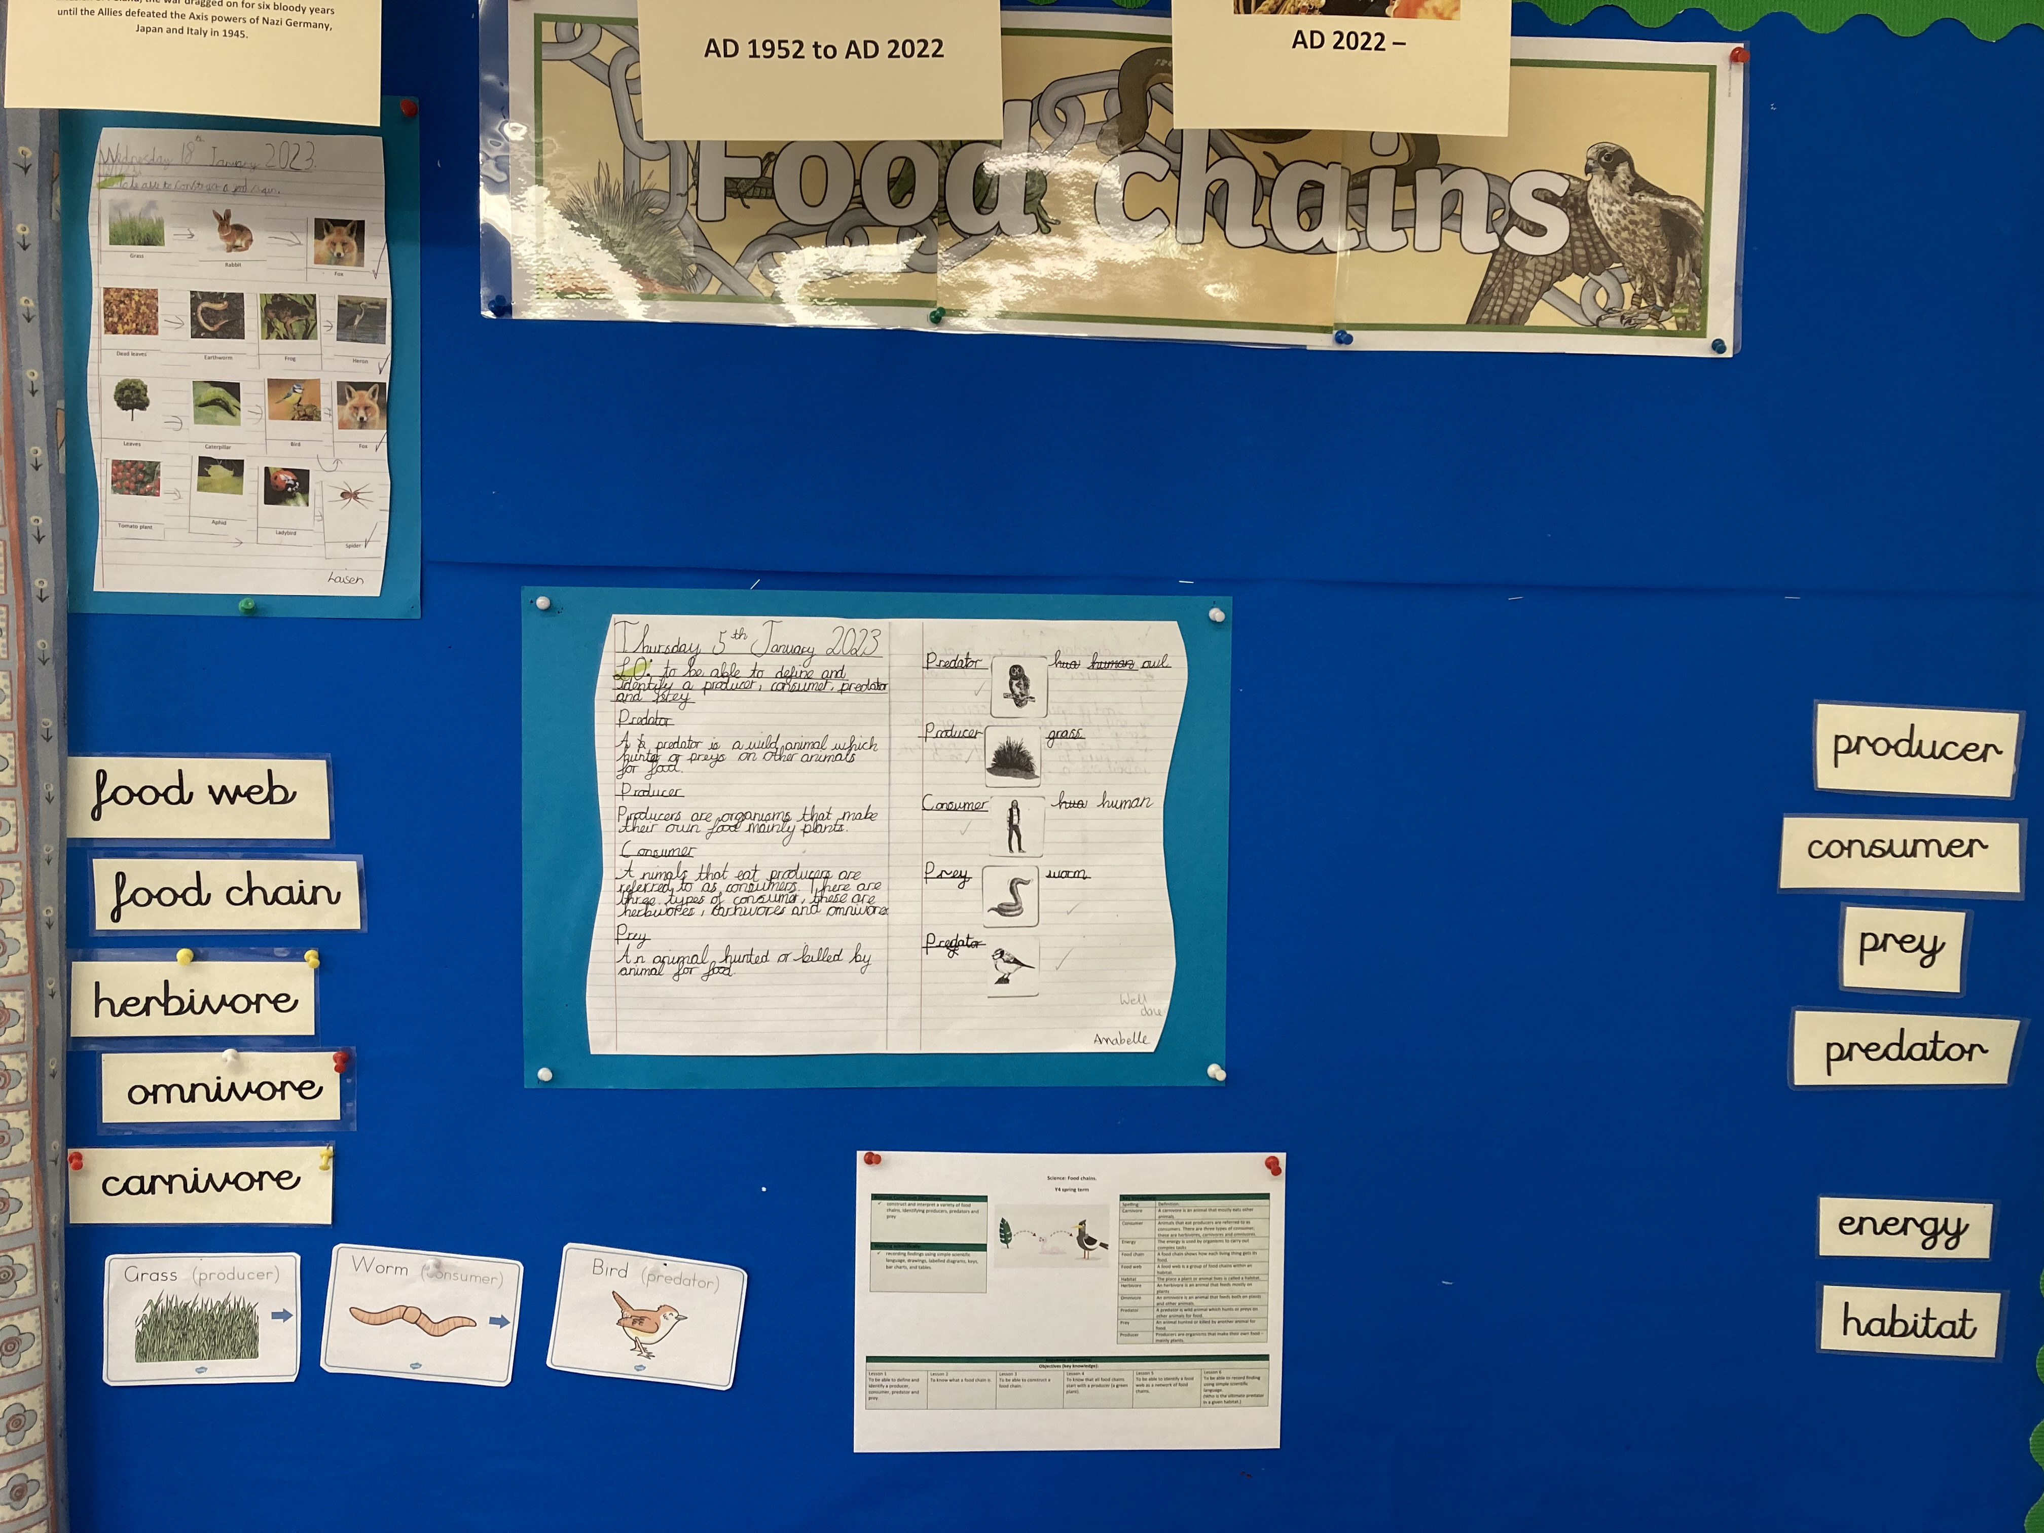
The displays, including Y4’s food chains science displays are added to as the learning sequence progresses.

Slide 5
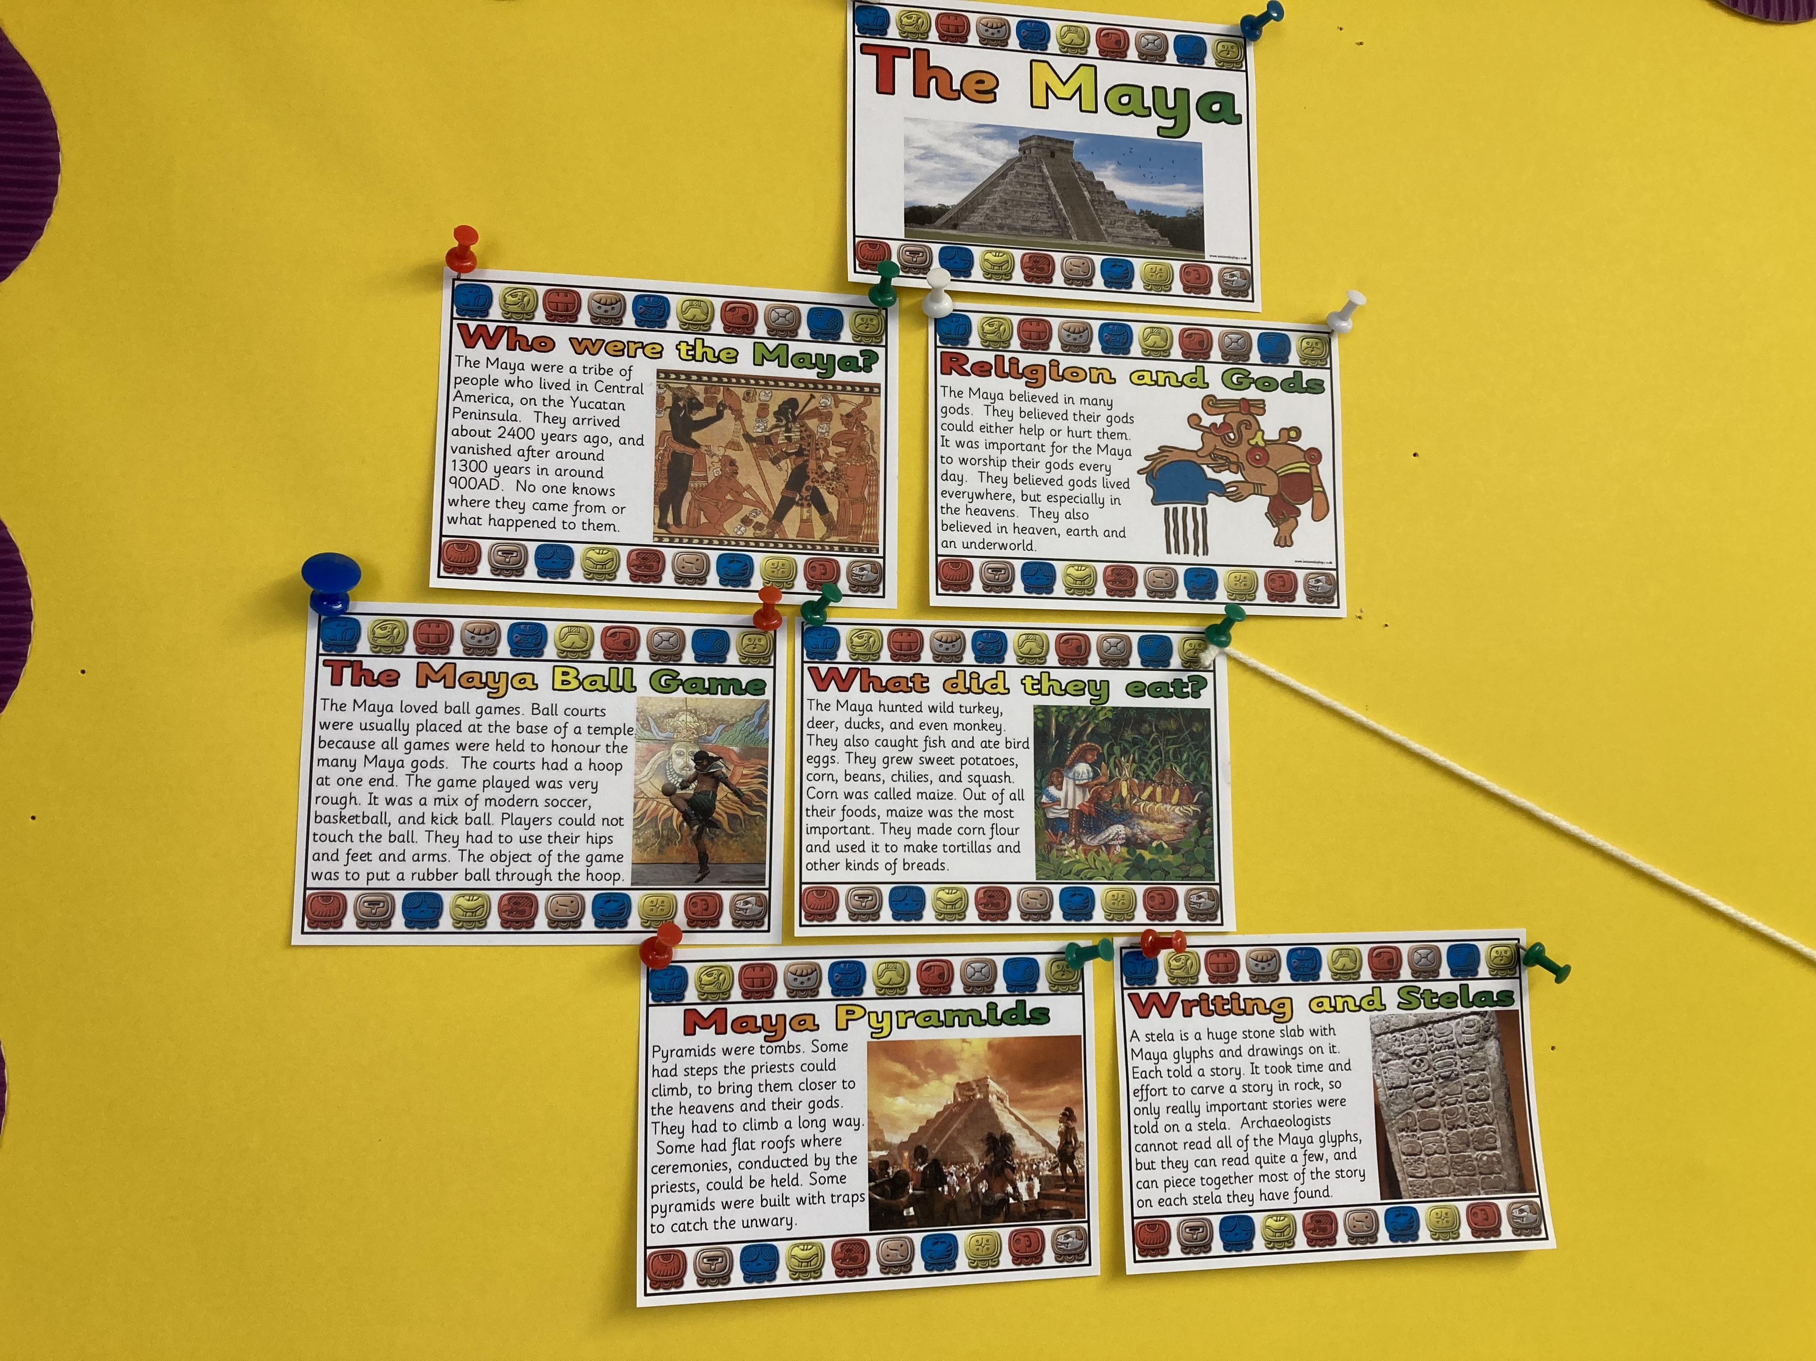
Y4 have added a great deal of key information about the Maya to their knowledge map. This includes the Maya religion and gods, their sports, their diet, their pyramids and their writing.

Slide 6
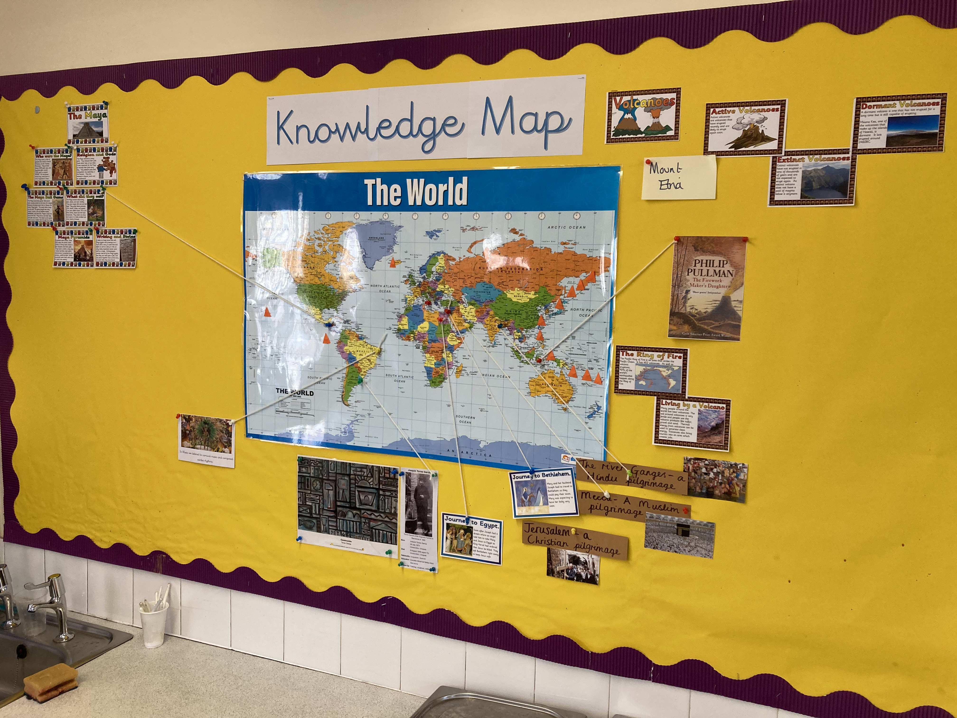
Y4 use their knowledge map as an ongoing, interactive learning resource. It is an integral part of teaching and learning, and the children make suggestions about information that can be added to it.

