Slide 1
Our learning environment #4
February 2023

Slide 2
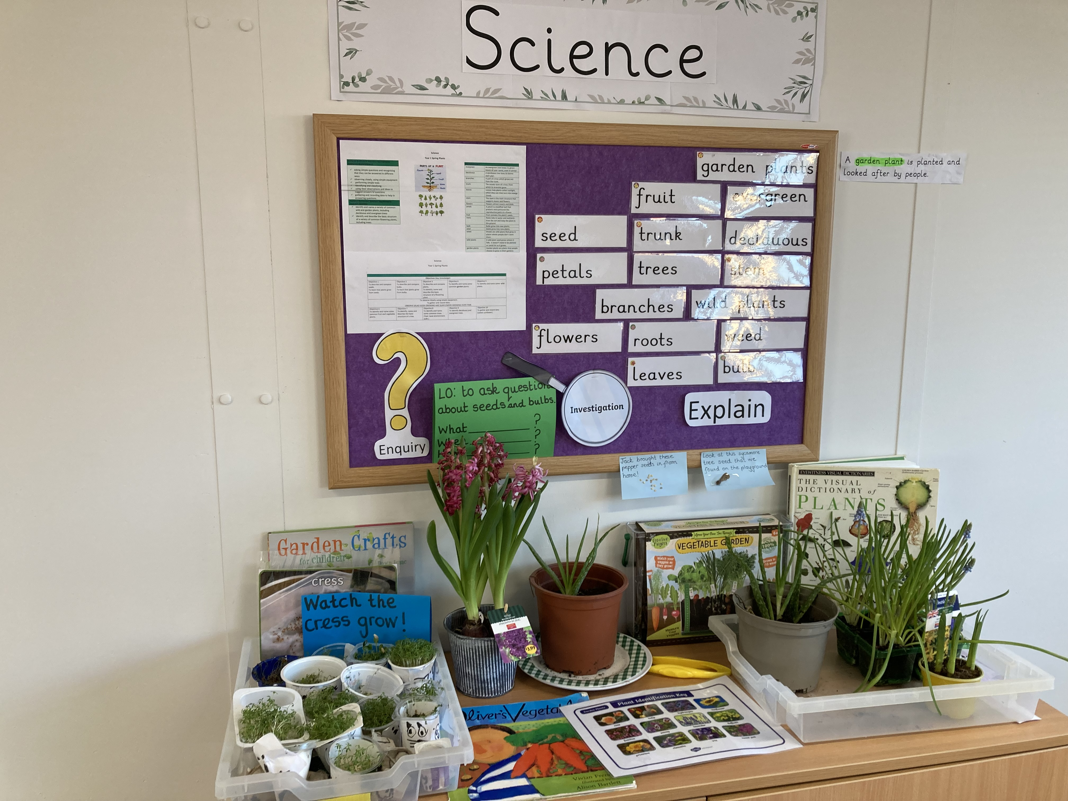
All of the Y1 vocabulary for their plants topic is displayed in our “Letter join” font. You can see the most recent objective: “to ask questions about seeds and bulbs”.

Slide 3
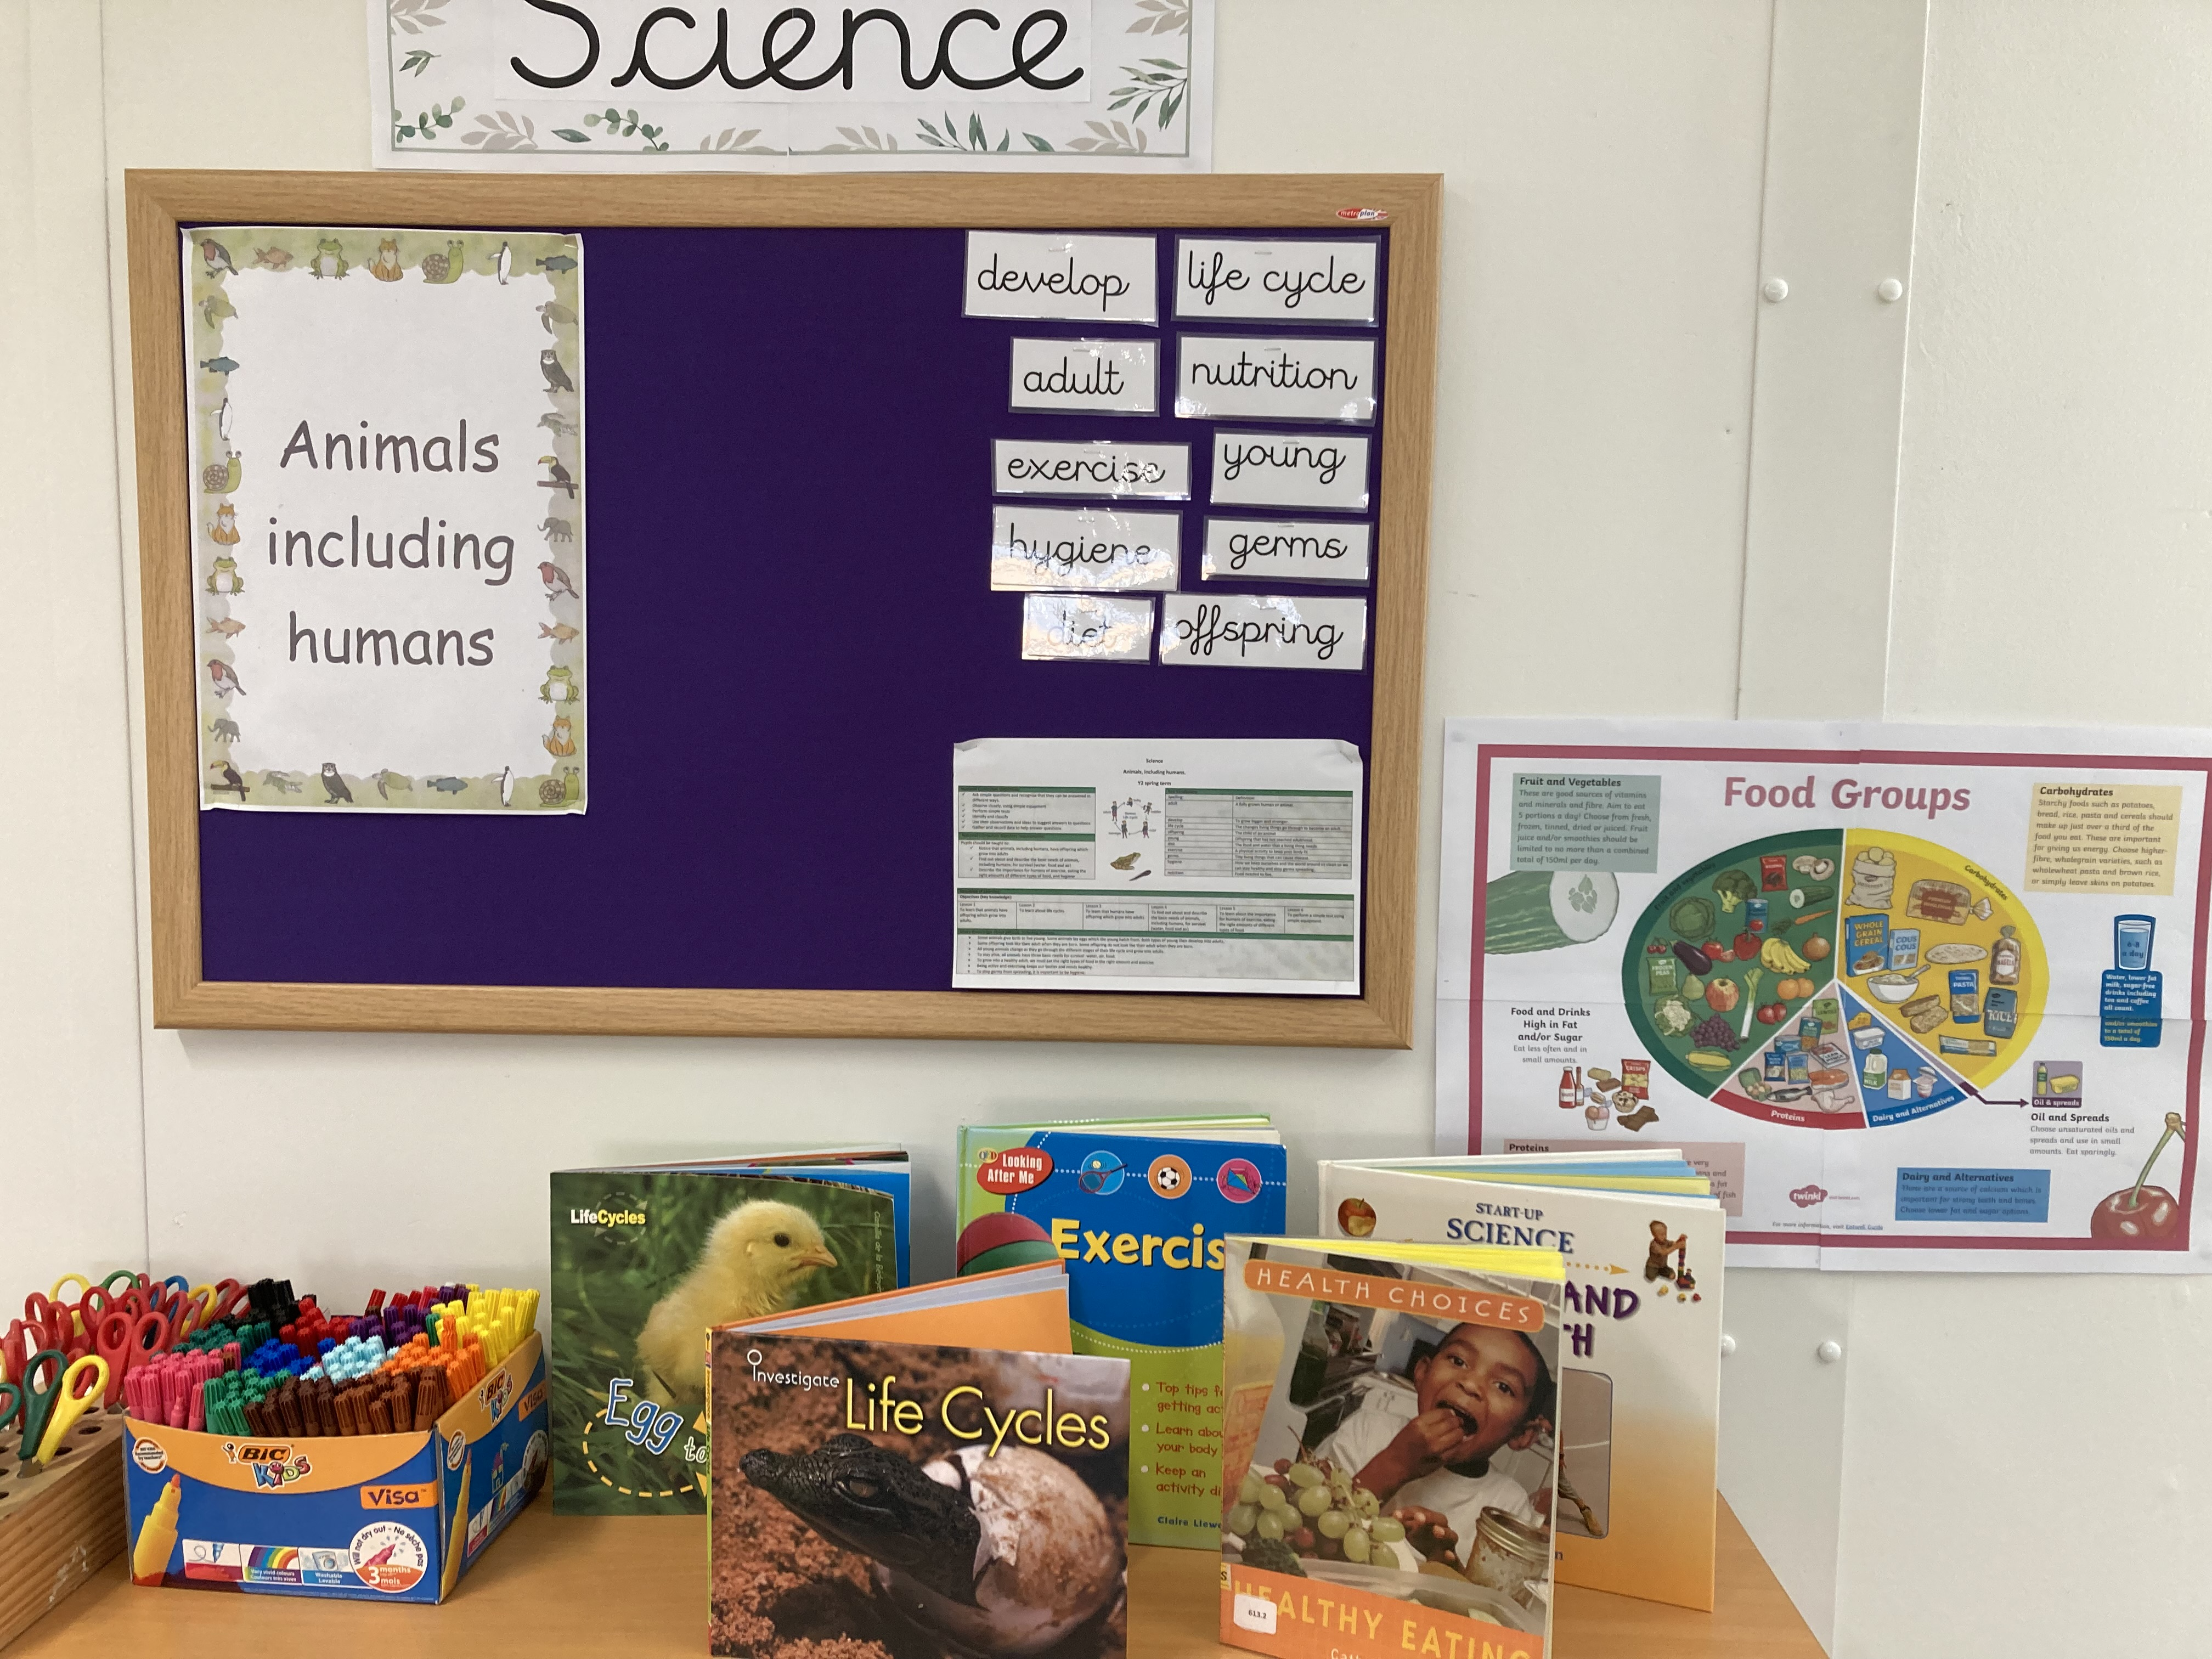
The Y2 team have been developing their
“Animals including humans” display. All of the key vocabulary is present, as well as the knowledge organiser showing the sequence of learning.
The children can also choose to read relevant books about healthy eating, exercise and life cycles.

Slide 4
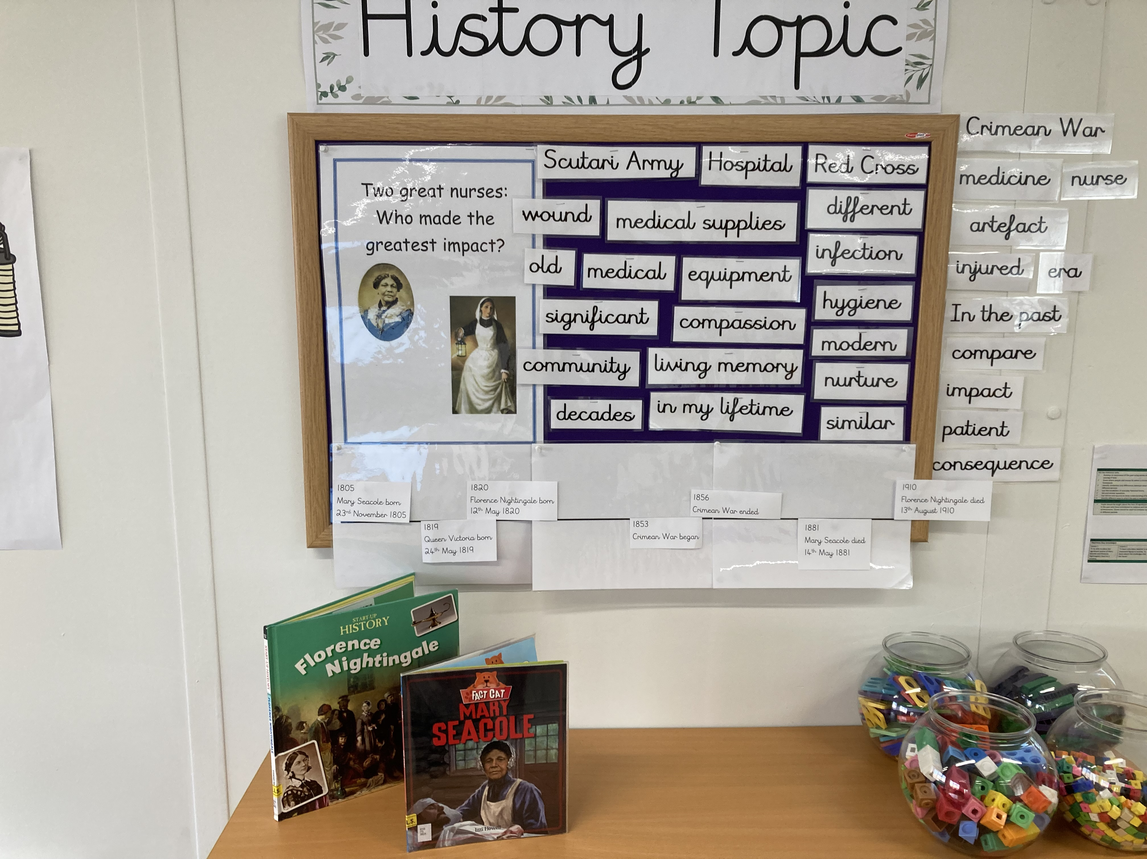
Y2’s history topic is: “Two great nurses: who made the greatest impact?” The timelines of Mary Seacole and Florence Nightingale are present and all of the relevant vocabulary is here to support the learning.

Slide 5
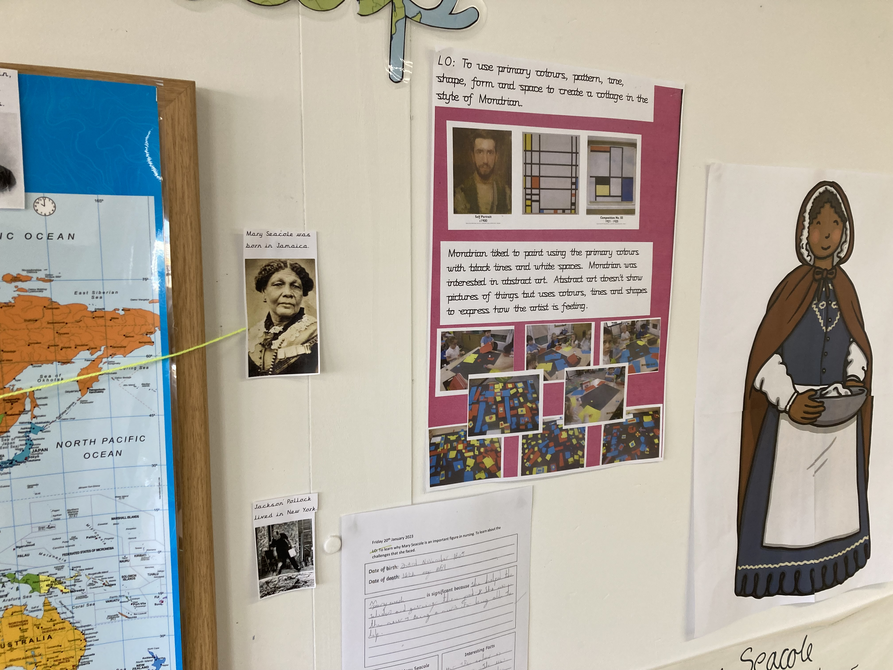
Y2’s knowledge map with Mary Seacole’s birthplace in Jamaica visible. You can see key information about Mondrian along with some of the children’s beautiful Mondrian-inspired art work.

Slide 6
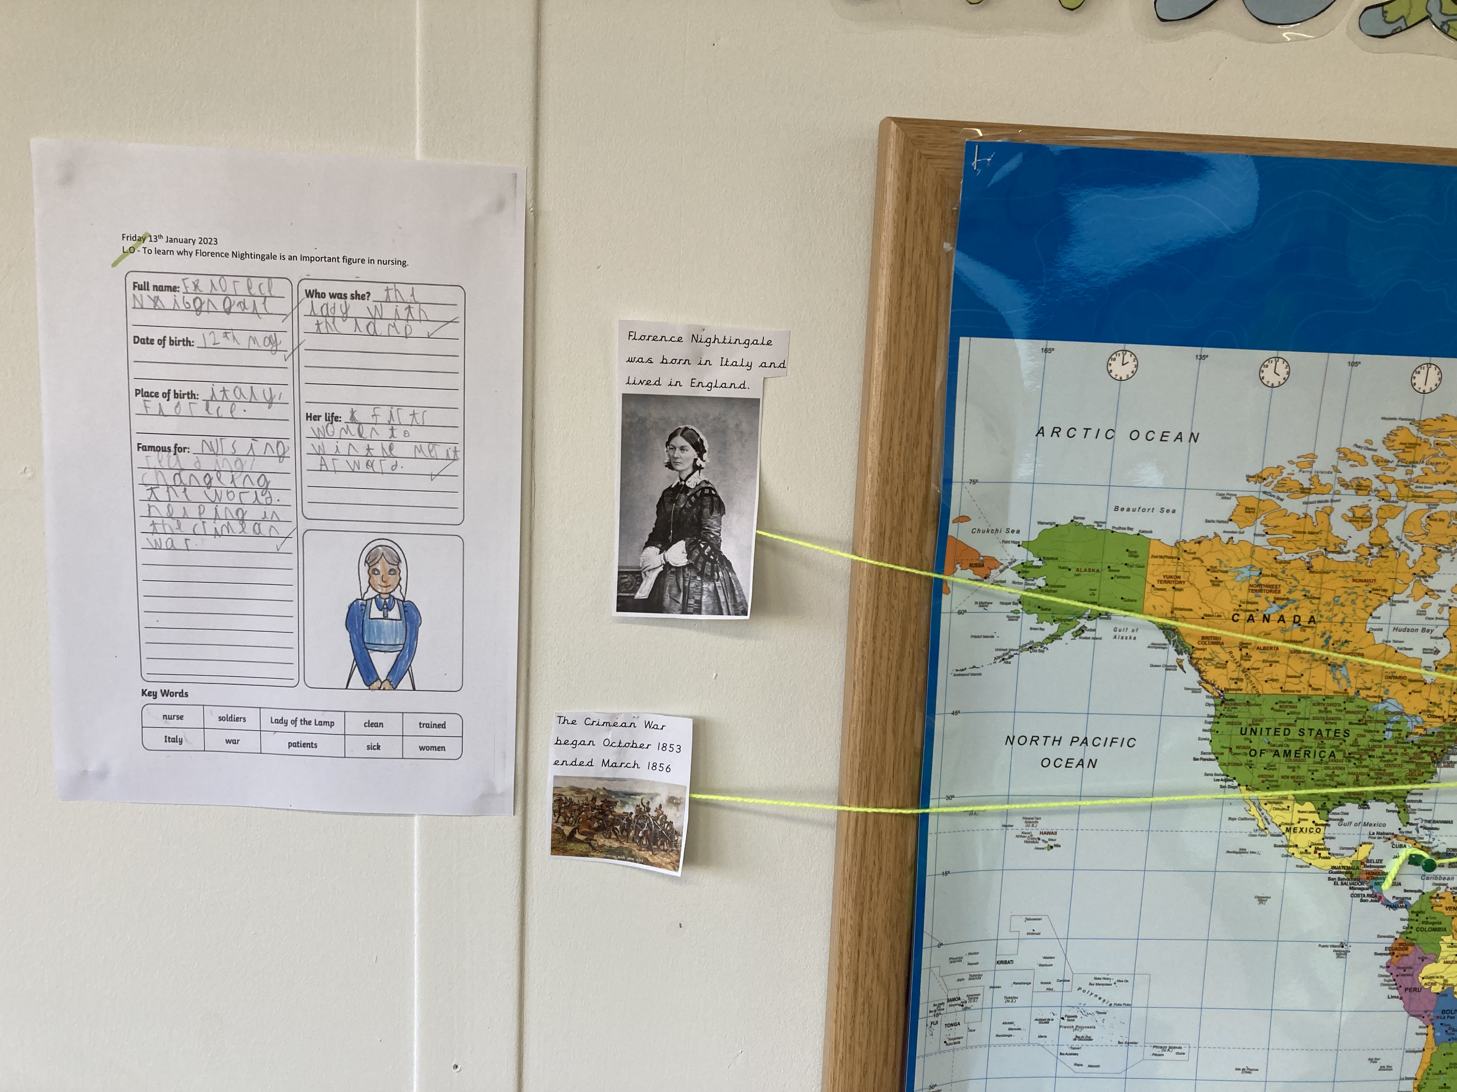
Y2’s knowledge map showing
Florence Nightingale’s birthplace in Italy and the setting of the Crimean War.
The knowledge maps are brilliant prompts that the children can refer back to.
They help the children to understand our world and the complexities of time and place.

