Slide 1


End of KS2 SATs
Parents’ Information
Class Name: Owls
Teacher: Miss S Brough

Slide 2
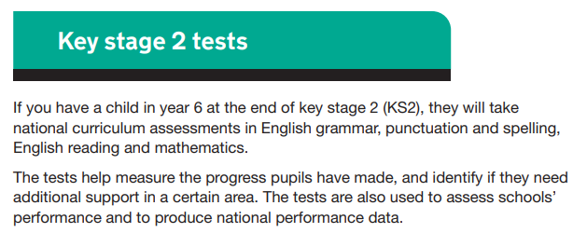
End of Key Stage 2 Assessments

Slide 3
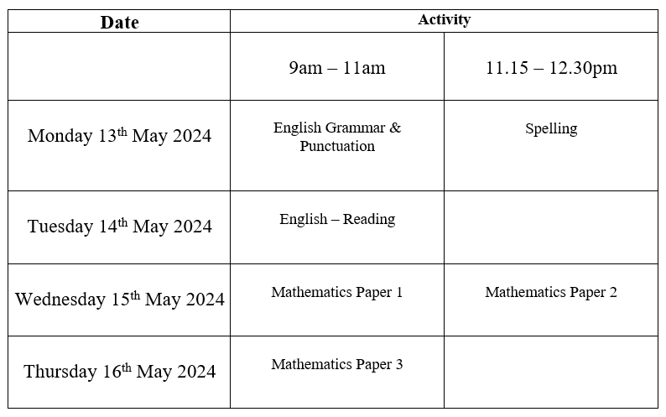
End of Key Stage 2 Assessments
Are timetabled from Monday 13th May 2024 to Thursday 16th May 2024.

Slide 4
Preparing for the assessments
Attend school regularly.
Read regularly at home (at least 3 times a week). This needs to be ongoing throughout the year.
Complete weekly maths homework tasks.
Practise for the weekly spelling tests.
Engage with Times Tables Rockstars.

Slide 5


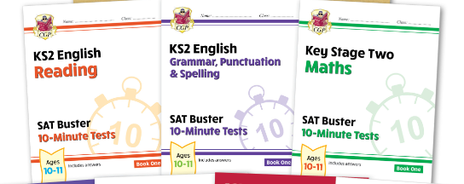


SATs resources
How can I support my child at home?
Grammar:
https://www.youtube.com/@Grammarsaurus this link includes songs to help with learning grammatical terms.
Home | Rollama · SPaG Superpowers · FREE 30-Day Trial You can sign up for a 30 day free trial which will give you access to lots of grammar games.
Maths:
Times Tables Rockstars https://ttrockstars.com/
Arithmetic practise: https://myminimaths.co.uk/year-6-arithmetic-practice-papers/
Reading: Reading at home 3 x a week can help with understanding vocabulary.
https://readtheory.org/ you can sign up to this for free and it will give your child comprehension questions matched to their ability.

Slide 6
Interventions and Boosters
In school interventions and after-school boosters are to “boost” your child’s score to give them the best opportunities to secure the expected standard.
All pupils will be offered additional opportunities to “boost” their scores either during the school day or as part of the after school boosters.

Slide 7
Any questions?
If you have any questions, please do not hesitate to ask me ☺

Slide 8
Thank you for attending.

