Slide 1
Our learning environment #2
February 2023

Slide 2
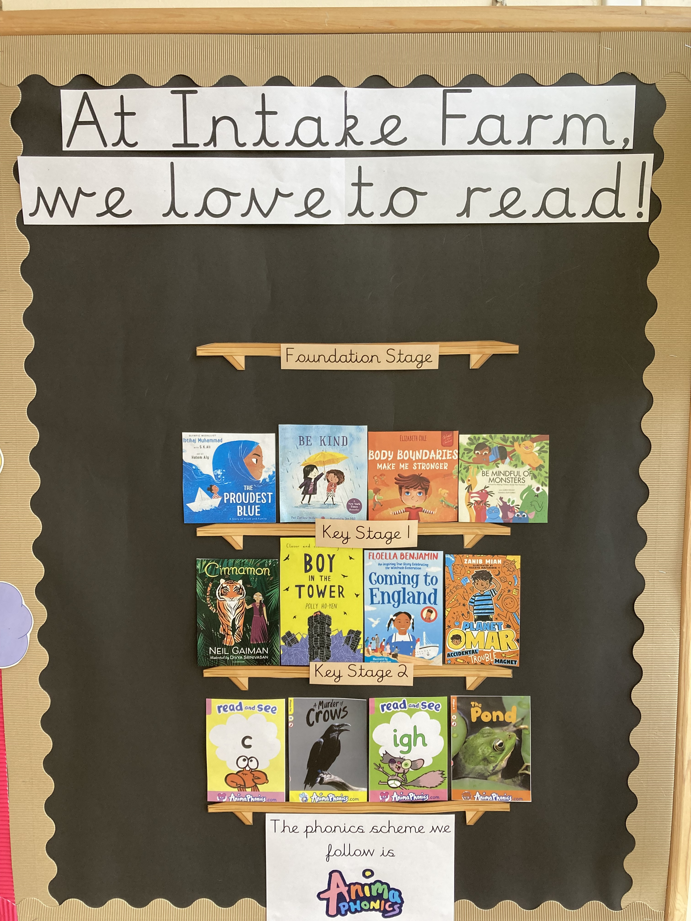
Intake Farm Primary is a “reading school”. Reading is the root of all learning and we all love to read.

Slide 3
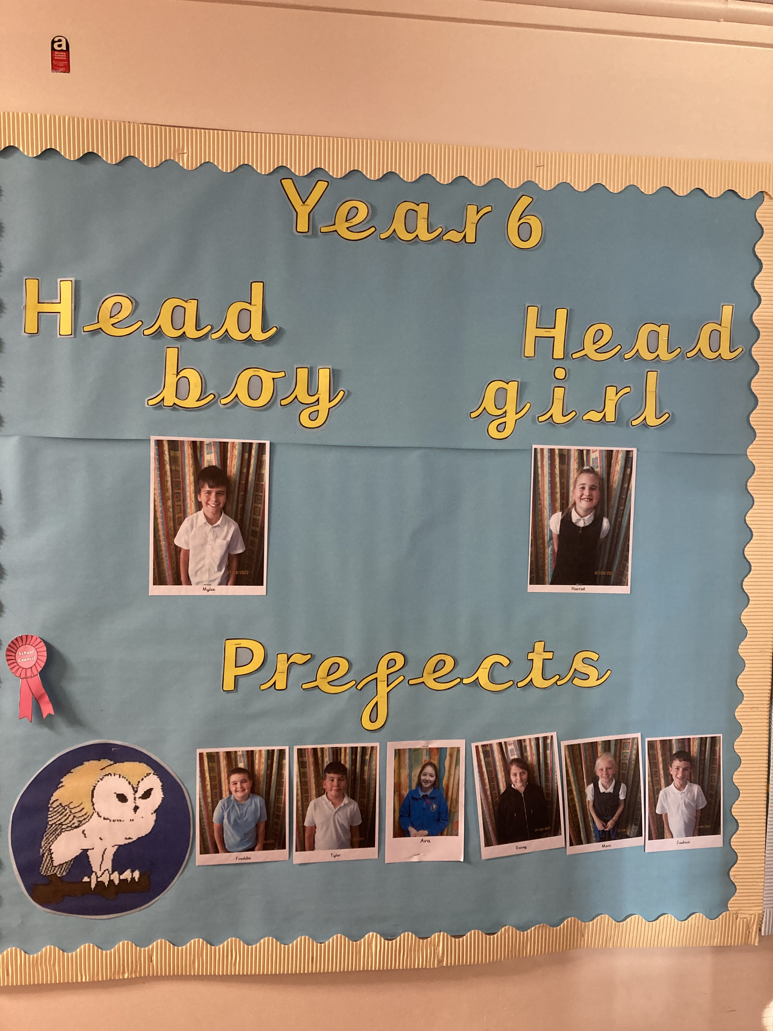
Our Head Boy, Head Girl and Prefects are responsible for representing the school. They serve as great roles model for the children and they share the children’s ideas with the School Council.

Slide 4
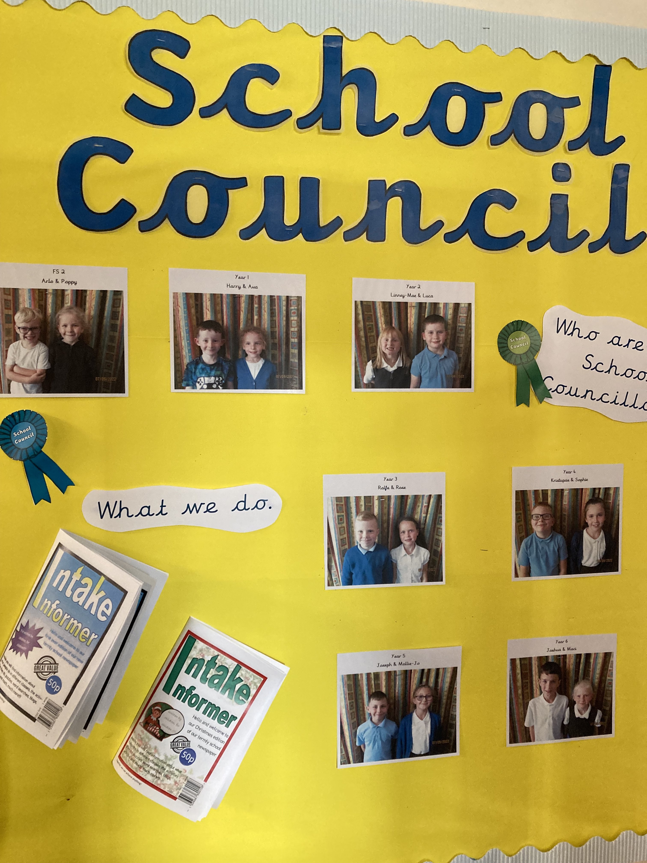
The School Council helps to make decisions about how the school is run. They provide a forum for the children to express their opinions and make decisions about school.

Slide 5
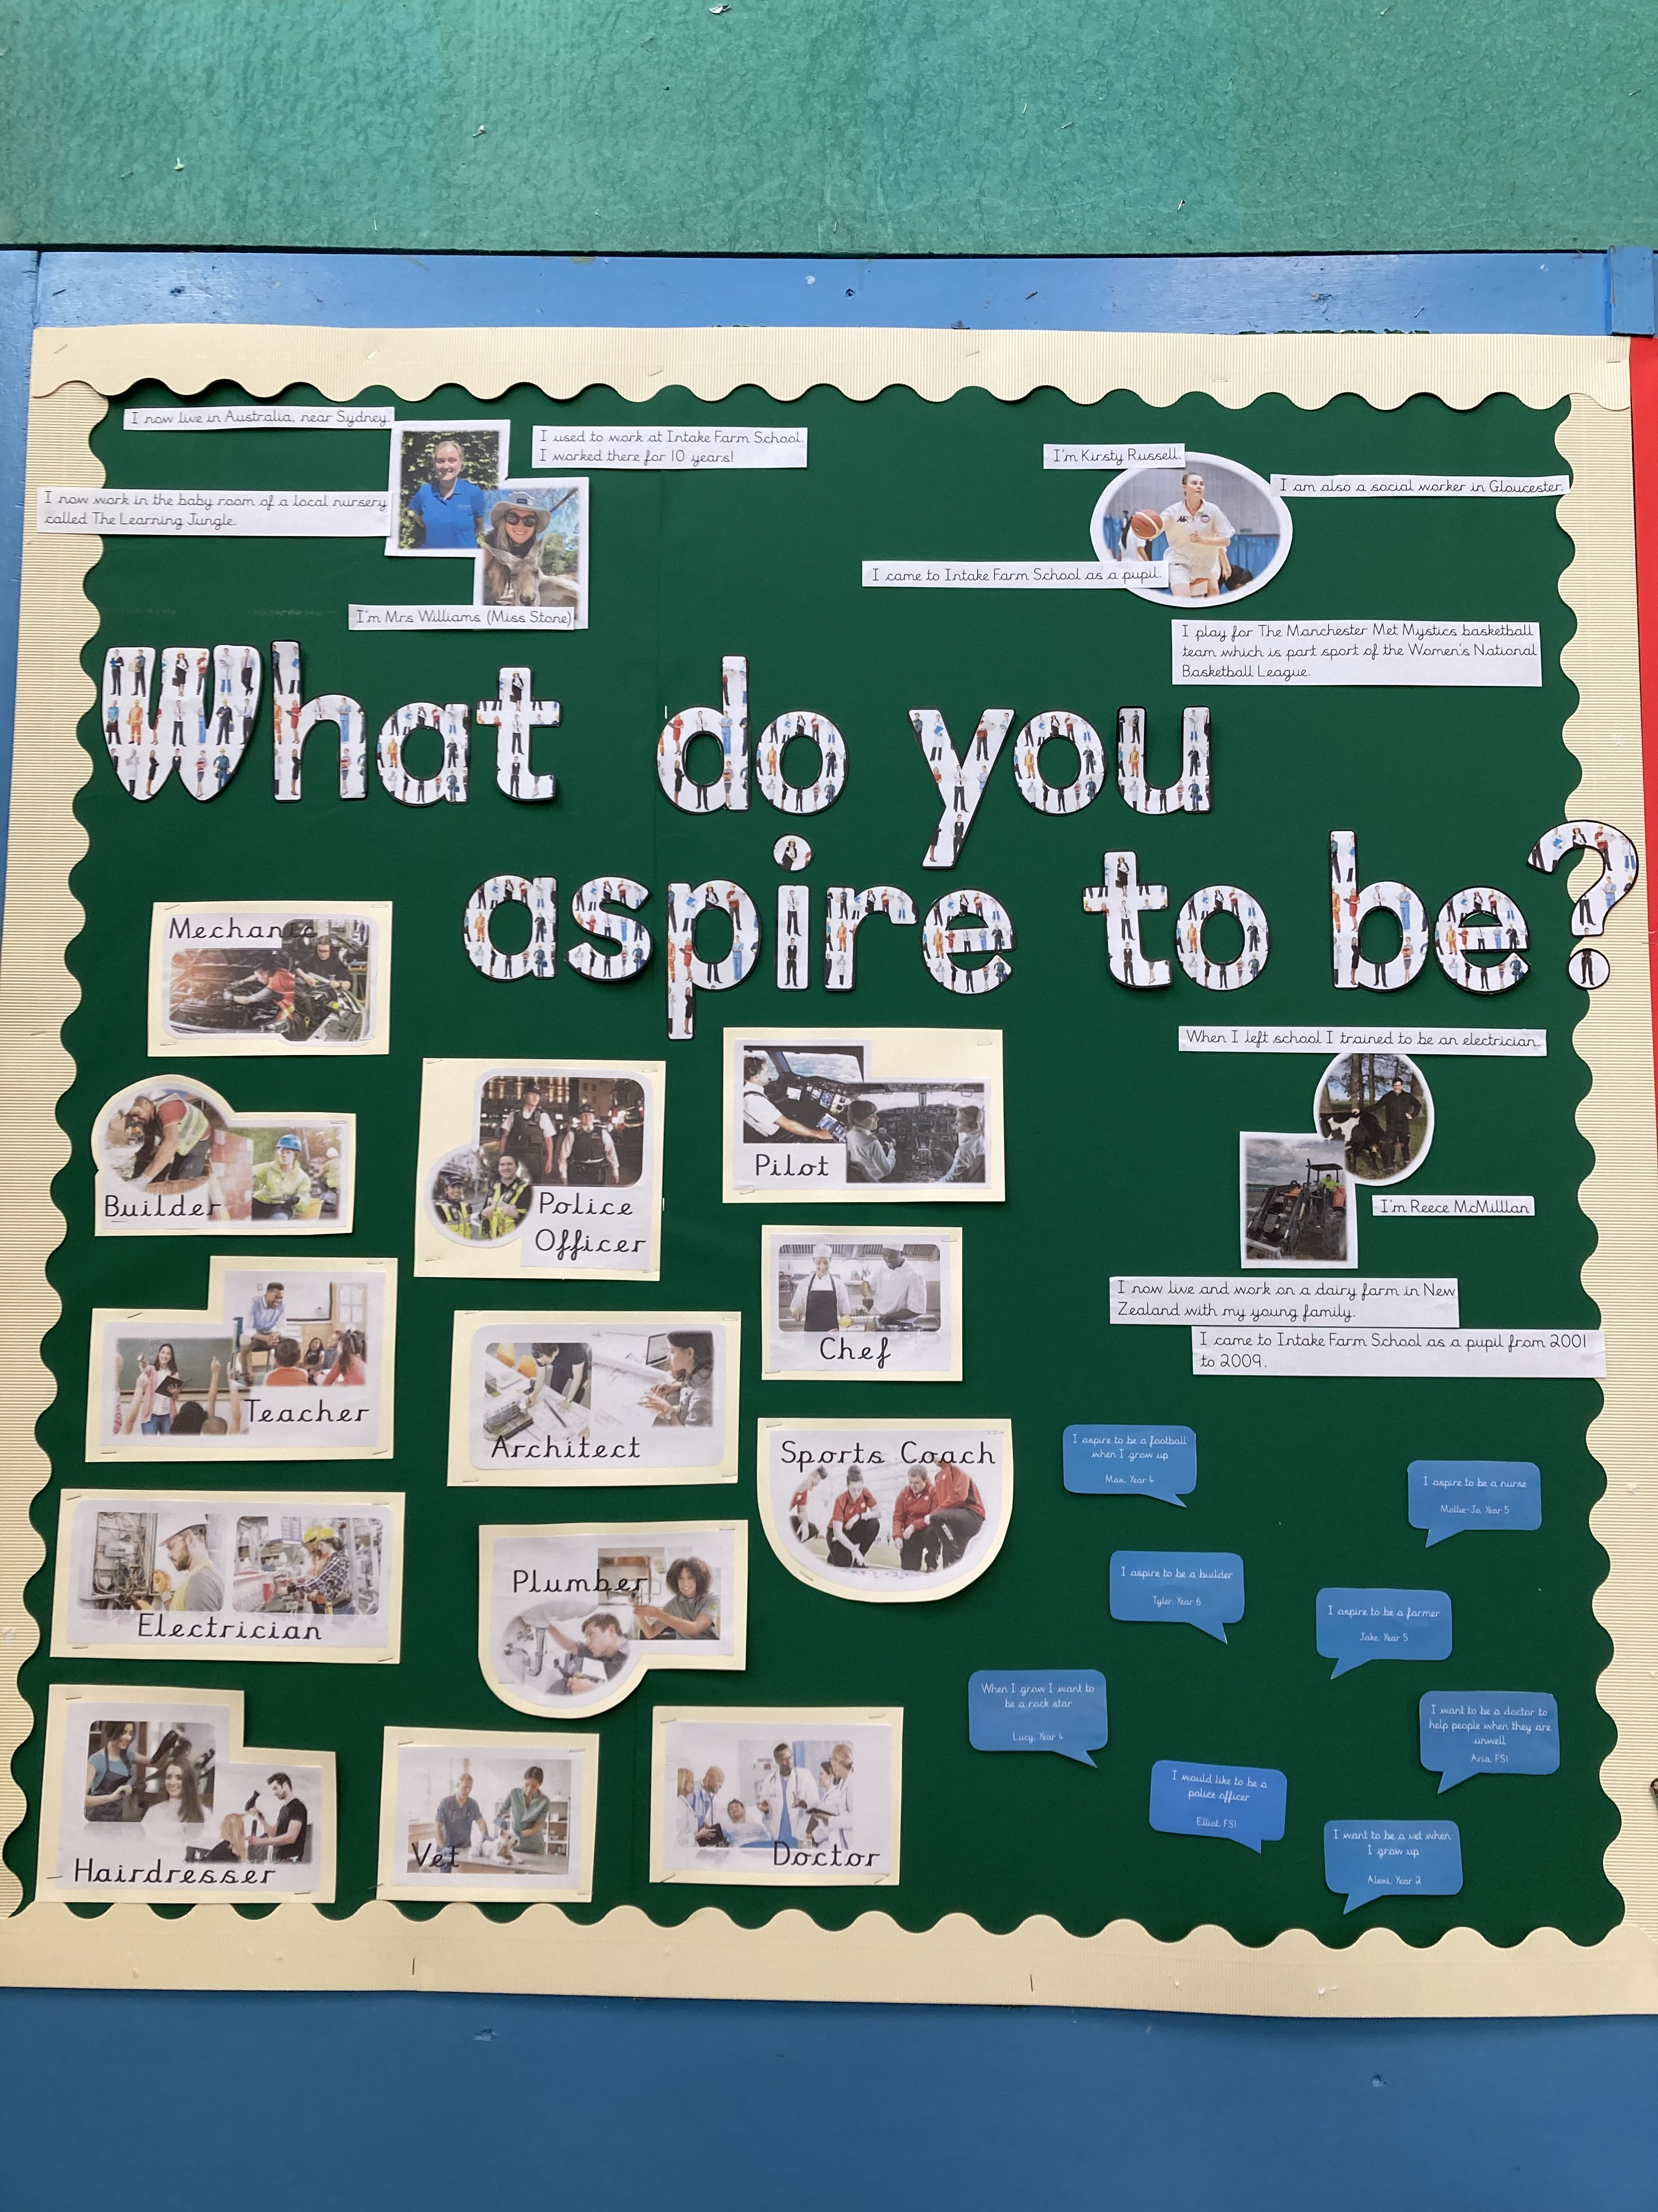
It’s great to have a vision for the future!
This display shows some of the jobs that our children could consider.
This display shows some actual ex-pupils of Intake
Farm and their exciting adventures of living and working abroad, e.g. in
Australia.

Slide 6
Our classrooms are interactive learning resources.
We create the physical, social and emotional conditions to support our children’s learning.
Our classroom environments support and enrich the learning of all children.
Our classrooms are vibrant and welcoming, but also each classroom is an interactive learning resource; a way of engaging the children and building the class community.
Our classrooms promote a sense of ownership. They are used to support learning and to celebrate children’s work.

Slide 7
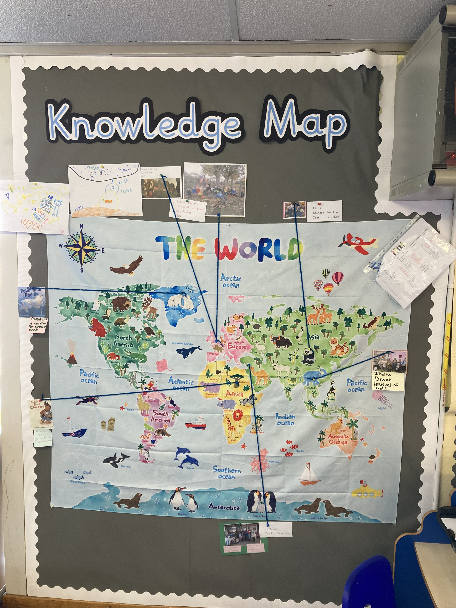
This is FS1’s knowledge
map. It is at children’s
eye level and it’s a real
talking point. The children
are interested in where all the a
animals come from and the
children love to follow the
lines. Extra information
is only added on when the
children are present.
The children contribute to the
knowledge map independently.

Slide 8
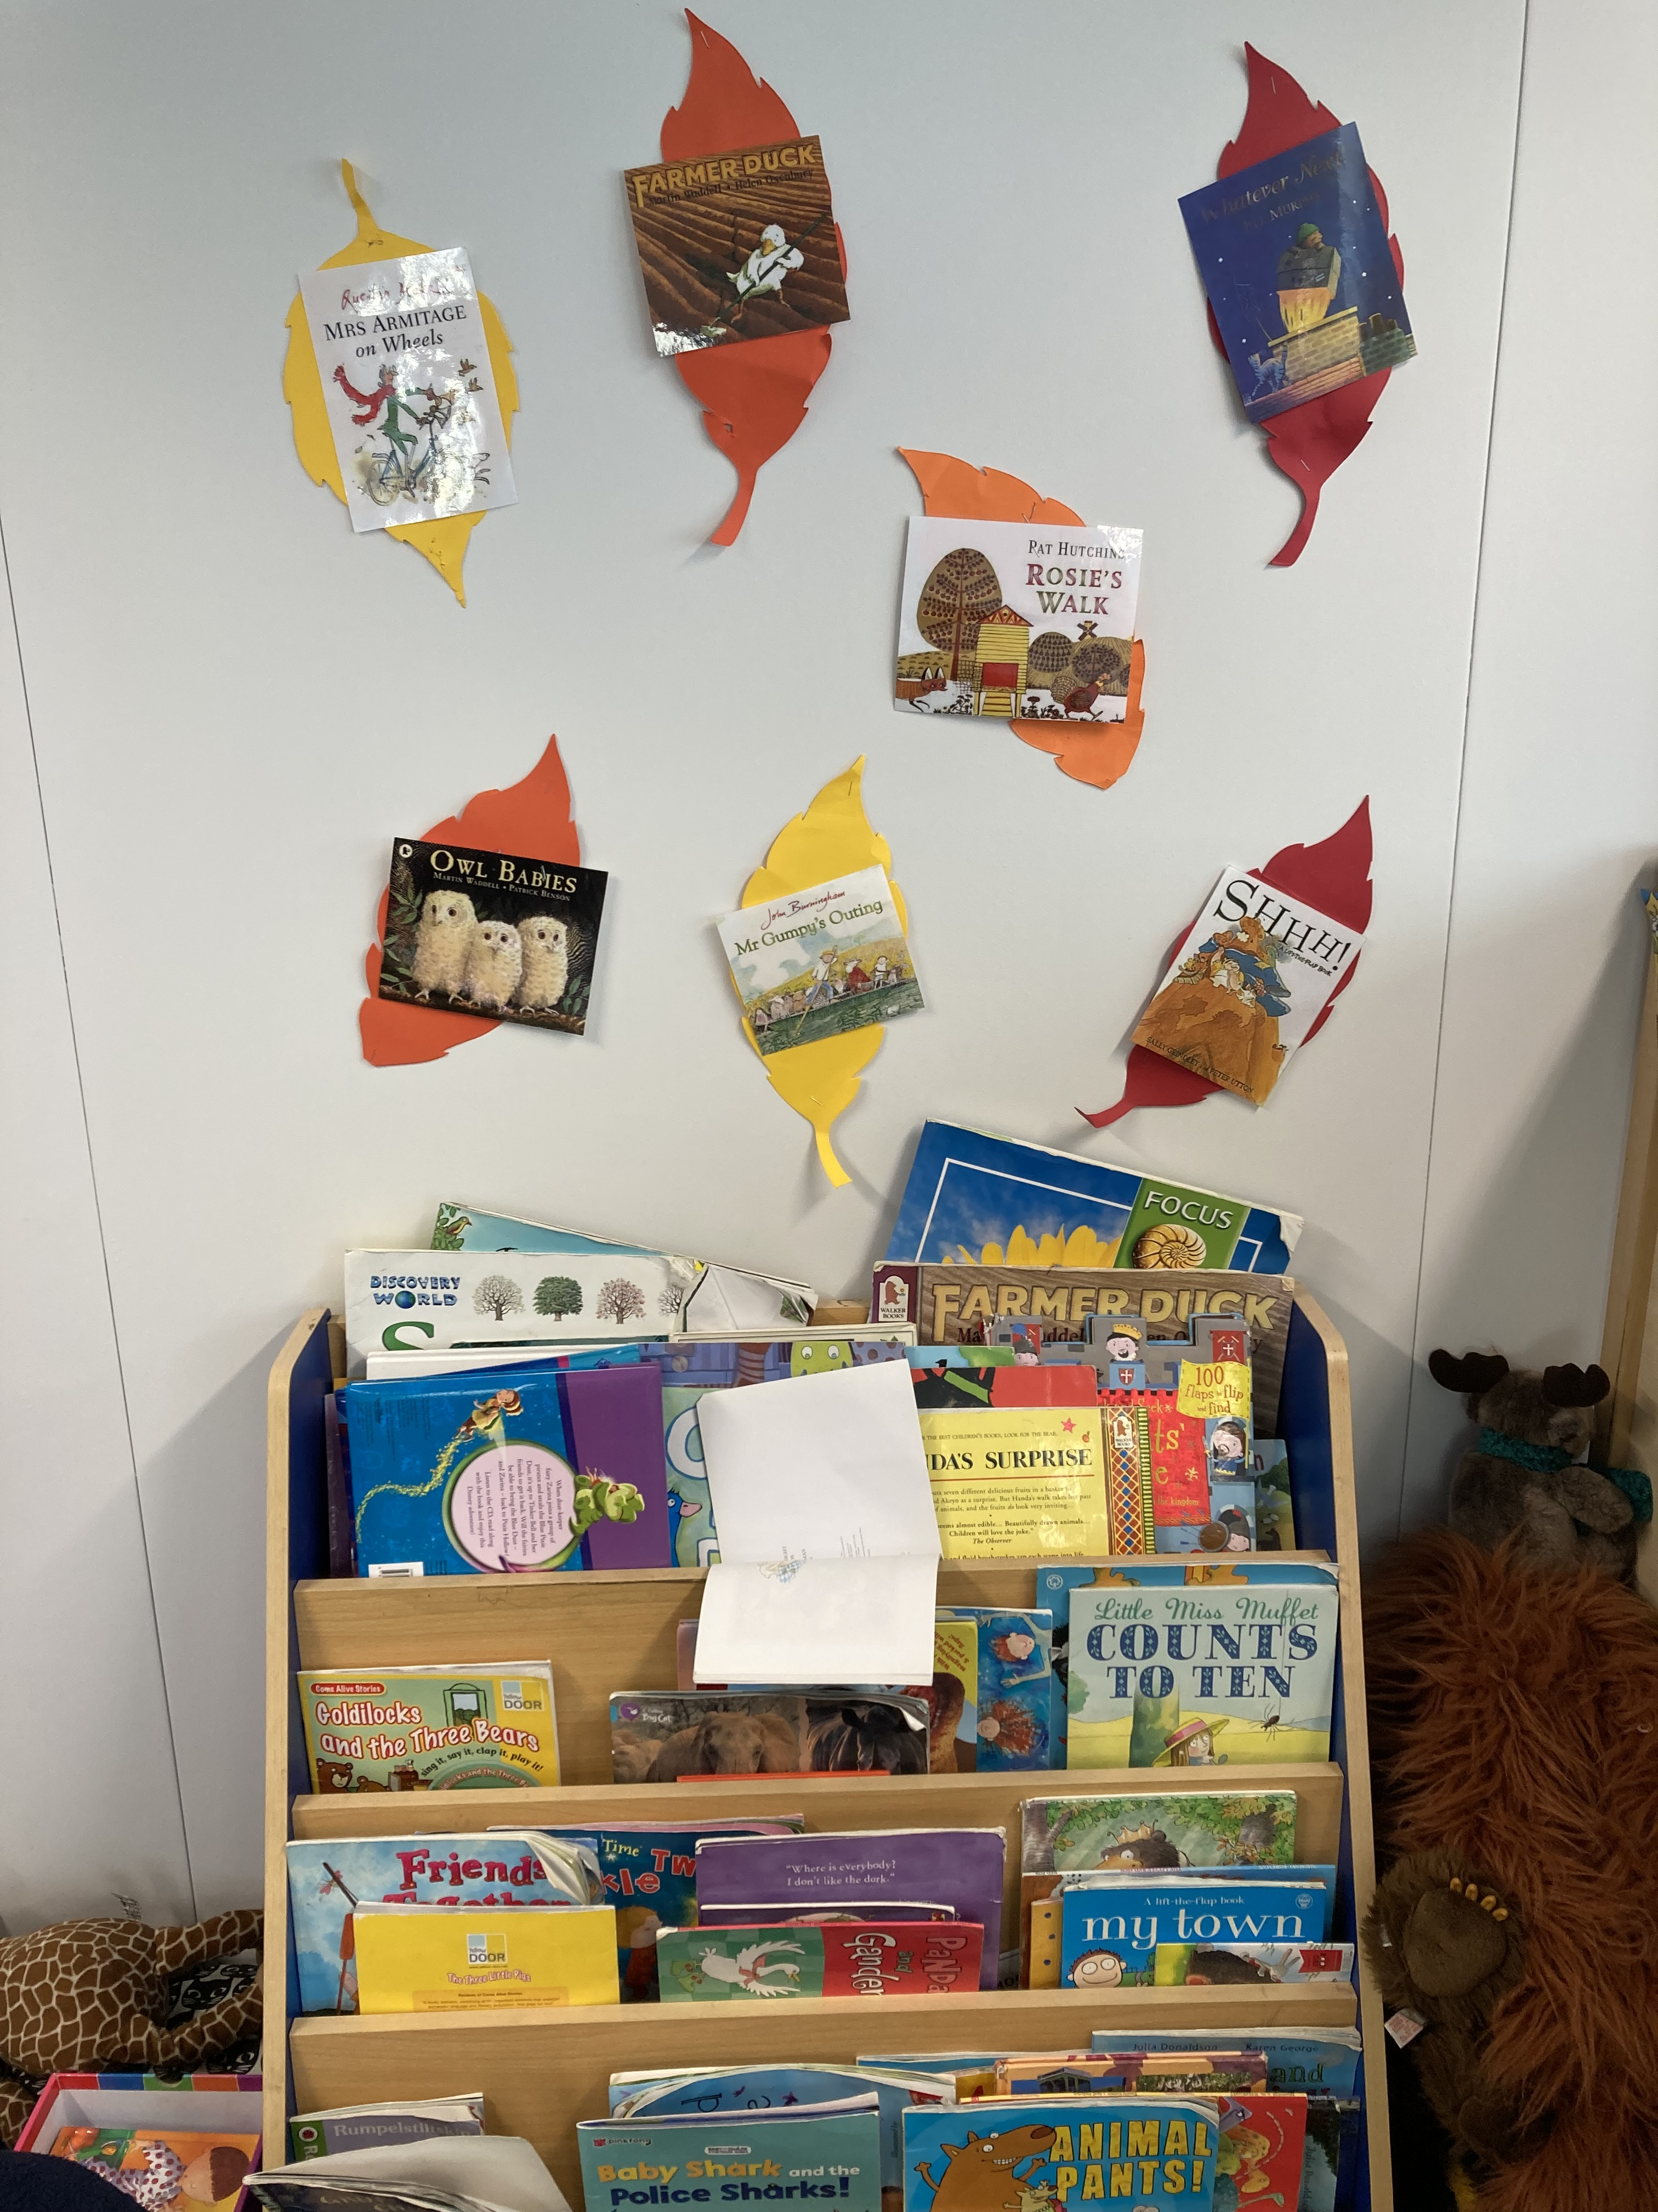
FS2’s reading display. A comfortable space where the children sit and read. This area is in use constantly!

Slide 9
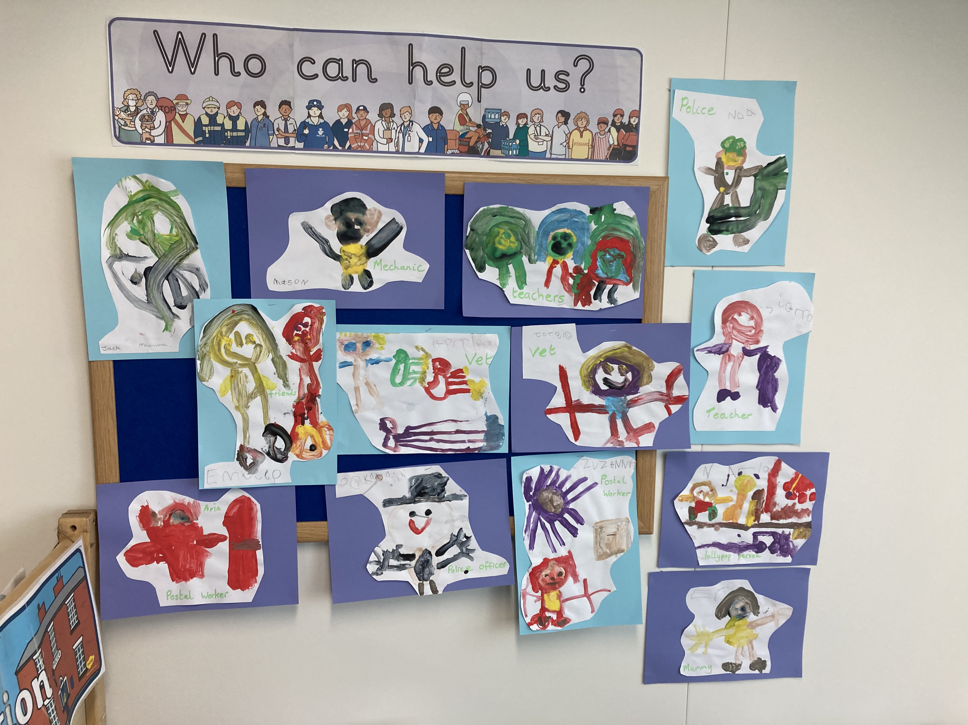
This FS2 display shows their topic: “Who can help us?” The children’s beautiful work is celebrated.

