Slide 1


Online Safety
Keeping ourselves and our children safe online.
Protecting children from harmful, inappropriate content.
Teaching children the importance of respectful interactions online.
Teaching children how to have healthy screen time habits.

Slide 2
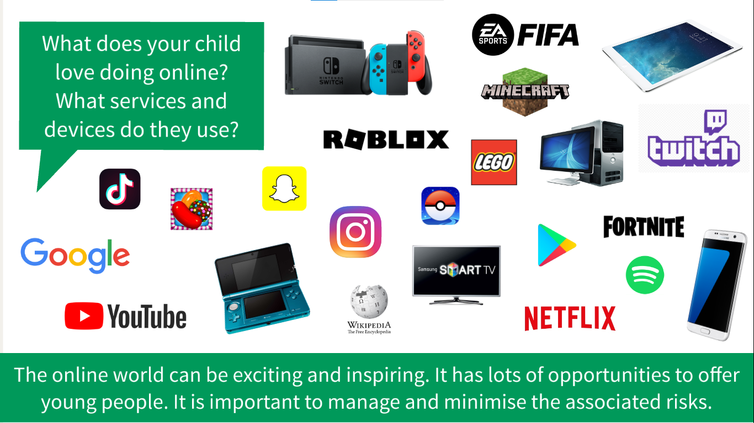

Slide 3
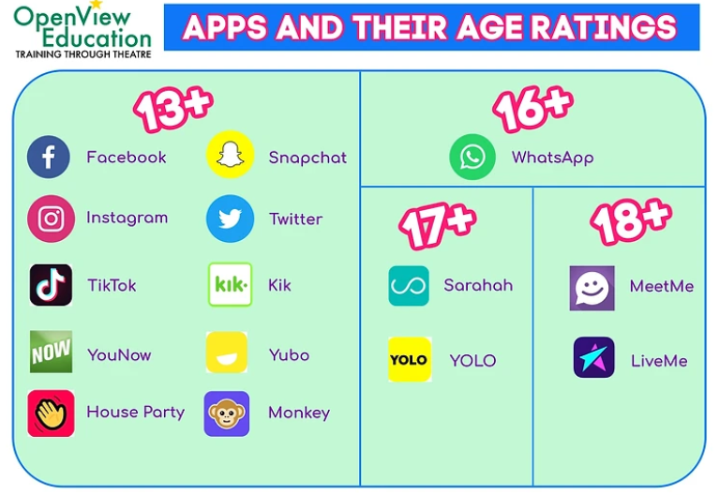

How many children have one or more of these apps?
Why do apps have age limits?
Some apps have a minimum age due to the content that is on them, this could be violent or upsetting, and by putting a false age children could be exposed to something that can be scary or harmful to them.

Slide 4
At intake farm we teach about Online Safety in two subjects. In the spring term, there is a dedicated strand in the PSHE curriculum that teaches about the internet and how we use it and how it can influence our decisions. In years 5 and 6 the children are taught to question the information available on the intent and to be aware that all may not be what it seem.
PSHE Media literacy and digital resilience | Media literacy and digital resilience
Year 1 | Using the internet and digital devices; communicating online.
Year 2 | The internet in everyday life; online content and information.
Year 3 | How the internet is used; assessing information online.
Year 4 | How data is shared and used.
Year 5 | How information online is targeted; different media types, their role and impact.
Year 6 | Evaluating media sources; sharing things online.
Foundation stage (PSED)
Know and talk about the different factors that support their overall health and wellbeing including sensible amounts of ‘screen time’.

Slide 5
Online safety is embedded in the computing curriculum across all years. We also explore online safety as a whole school on Safe Internet Day. This year’s focus was ‘Want to talk about it?’
Computing Scheme of Work (Purple Mash) | Media literacy and digital resilience
Year 1 | Safe logins. Technology outside school.
Year 2 | Searching and sharing. Email. Digital footprint.
Year 3 | Safe passwords. Fact or fiction? Appropriate content and ratings. Using email safely.
Year 4 | Phising. Malware. Plagerism. Screen time.
Year 5 | Responsibilities and support online. Protecting privacy. Reliability.
Year 6 | Messaging in a game. Online behaviour. Screen time.
National Curriculum for Computing
KS1
use technology safely and respectfully, keeping personal information private; identify where to go for help and support when they have concerns about content or contact on the internet or other online technologies
KS2
use technology safely, respectfully and responsibly; recognise acceptable/unacceptable behaviour; identify a range of ways to report concerns about content and contact

Slide 6

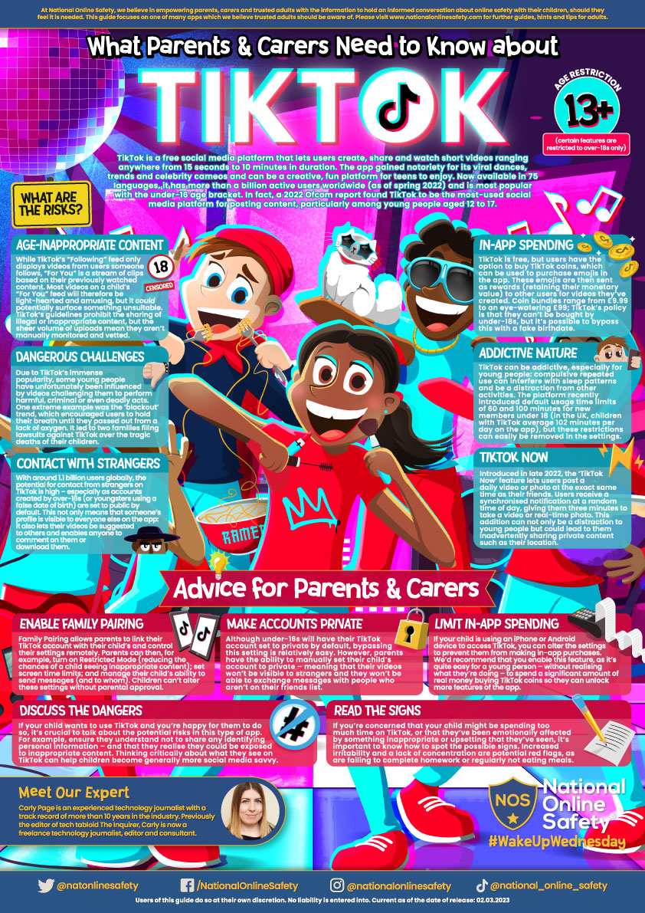
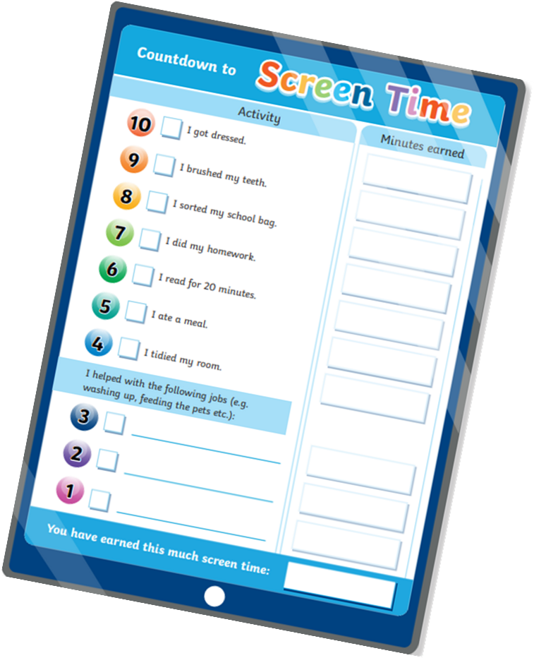
What parents can do at home?
Be aware of what your child is doing online.
Know what apps they have. Encourage use of age-appropriate apps e.g. YouTube kids.
Know who your children are the chatting to.
Limit screen time.
Set up downtime limits.
Keep phones out of bedrooms.
Talk to your children about the potential dangers online and make it clear that they must come to you with anything that makes them feel uncomfortable.
Learn to set restrictions in apps such as turning off location services.
Example
https://nationalonlinesafety.com/hub/view/guide/tiktok-2022

Slide 7
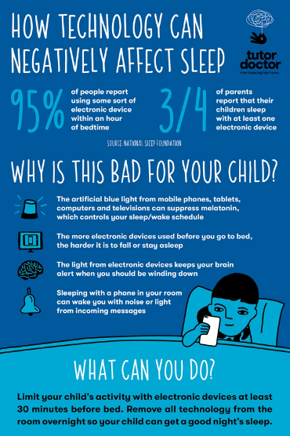
Why is it important to reduce screen time.
It improves physical health.
Improves sleep patterns.
Playing with friends in real life,
Reduces stress and improves mood.

Slide 8
Reporting inappropriate contact online.
Visit CEOP website - Child Exploitation and Online Protection
Here you will find guidance about how to report worrying behaviour. Examples of concerns that children have been reported include:
Someone online has asked me to send them nude images.
I shared a nude image with someone online and they are threatening me.
I did something that I was embarrassed about on webcam and someone has turned nasty towards me.
Someone I don't know is asking me to live-stream and do things I don't want to do.
Someone online kept asking me to meet them face-to-face and I feel pressured by them.
Someone online was talking to me about sex and it made me feel uncomfortable.
Someone online is putting pressure on me to do things I don't want to do.
Someone I met in an online game keeps trying to talk to me privately.
https://www.ceop.police.uk/safety-centre/

Slide 9
Where to get advice. some useful websites to visit.
https://www.childnet.com/
https://www.internetmatters.org/resources/apps-guide/
https://nationalonlinesafety.com/
https://www.nspcc.org.uk/keeping-children-safe/online-safety/
https://www.gov.uk/government/publications/child-safety-online-a-practical-guide-for-parents-and-carers/
https://saferinternet.org.uk/

