Slide 1
Our learning environment
February 2023

Slide 2
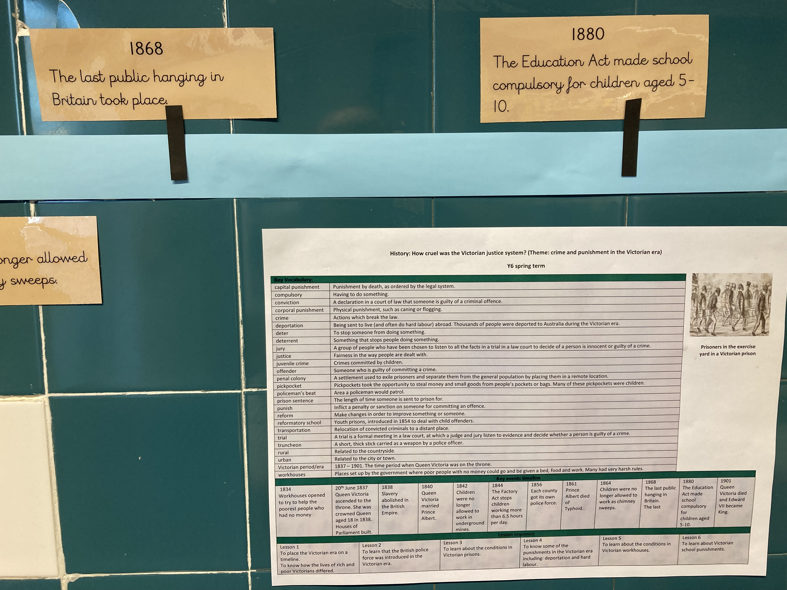
Y6’s bespoke Victorian timeline and knowledge organiser. You can see when the last public hanging was as well as when education for children became compulsory.

Slide 3
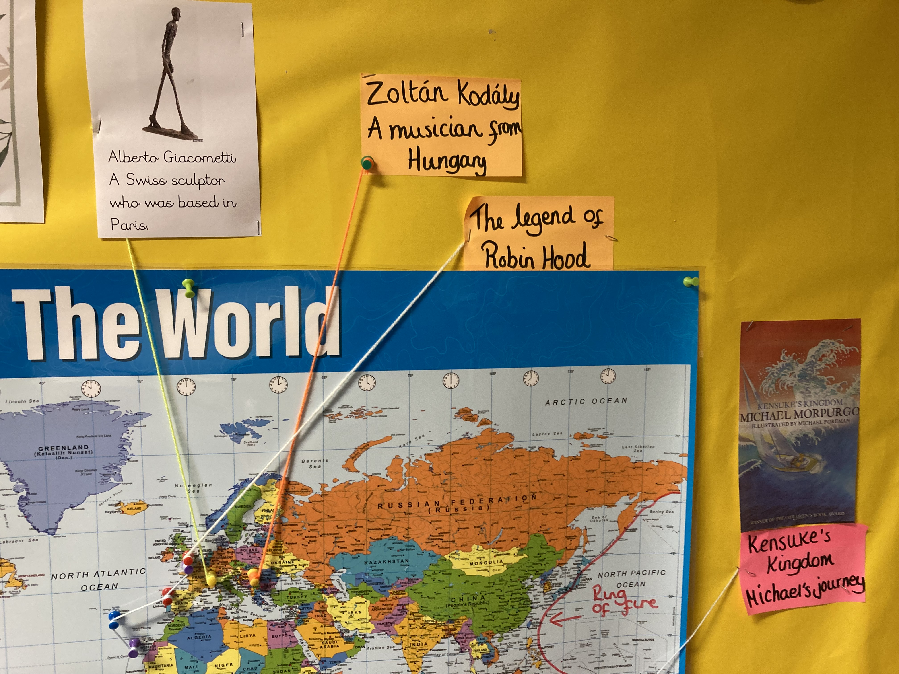
You can see a combination of teacher and TA-scribed notes, and annotations showing key information, e.g. information about Giacometti, the Swiss sculptor.

Slide 4
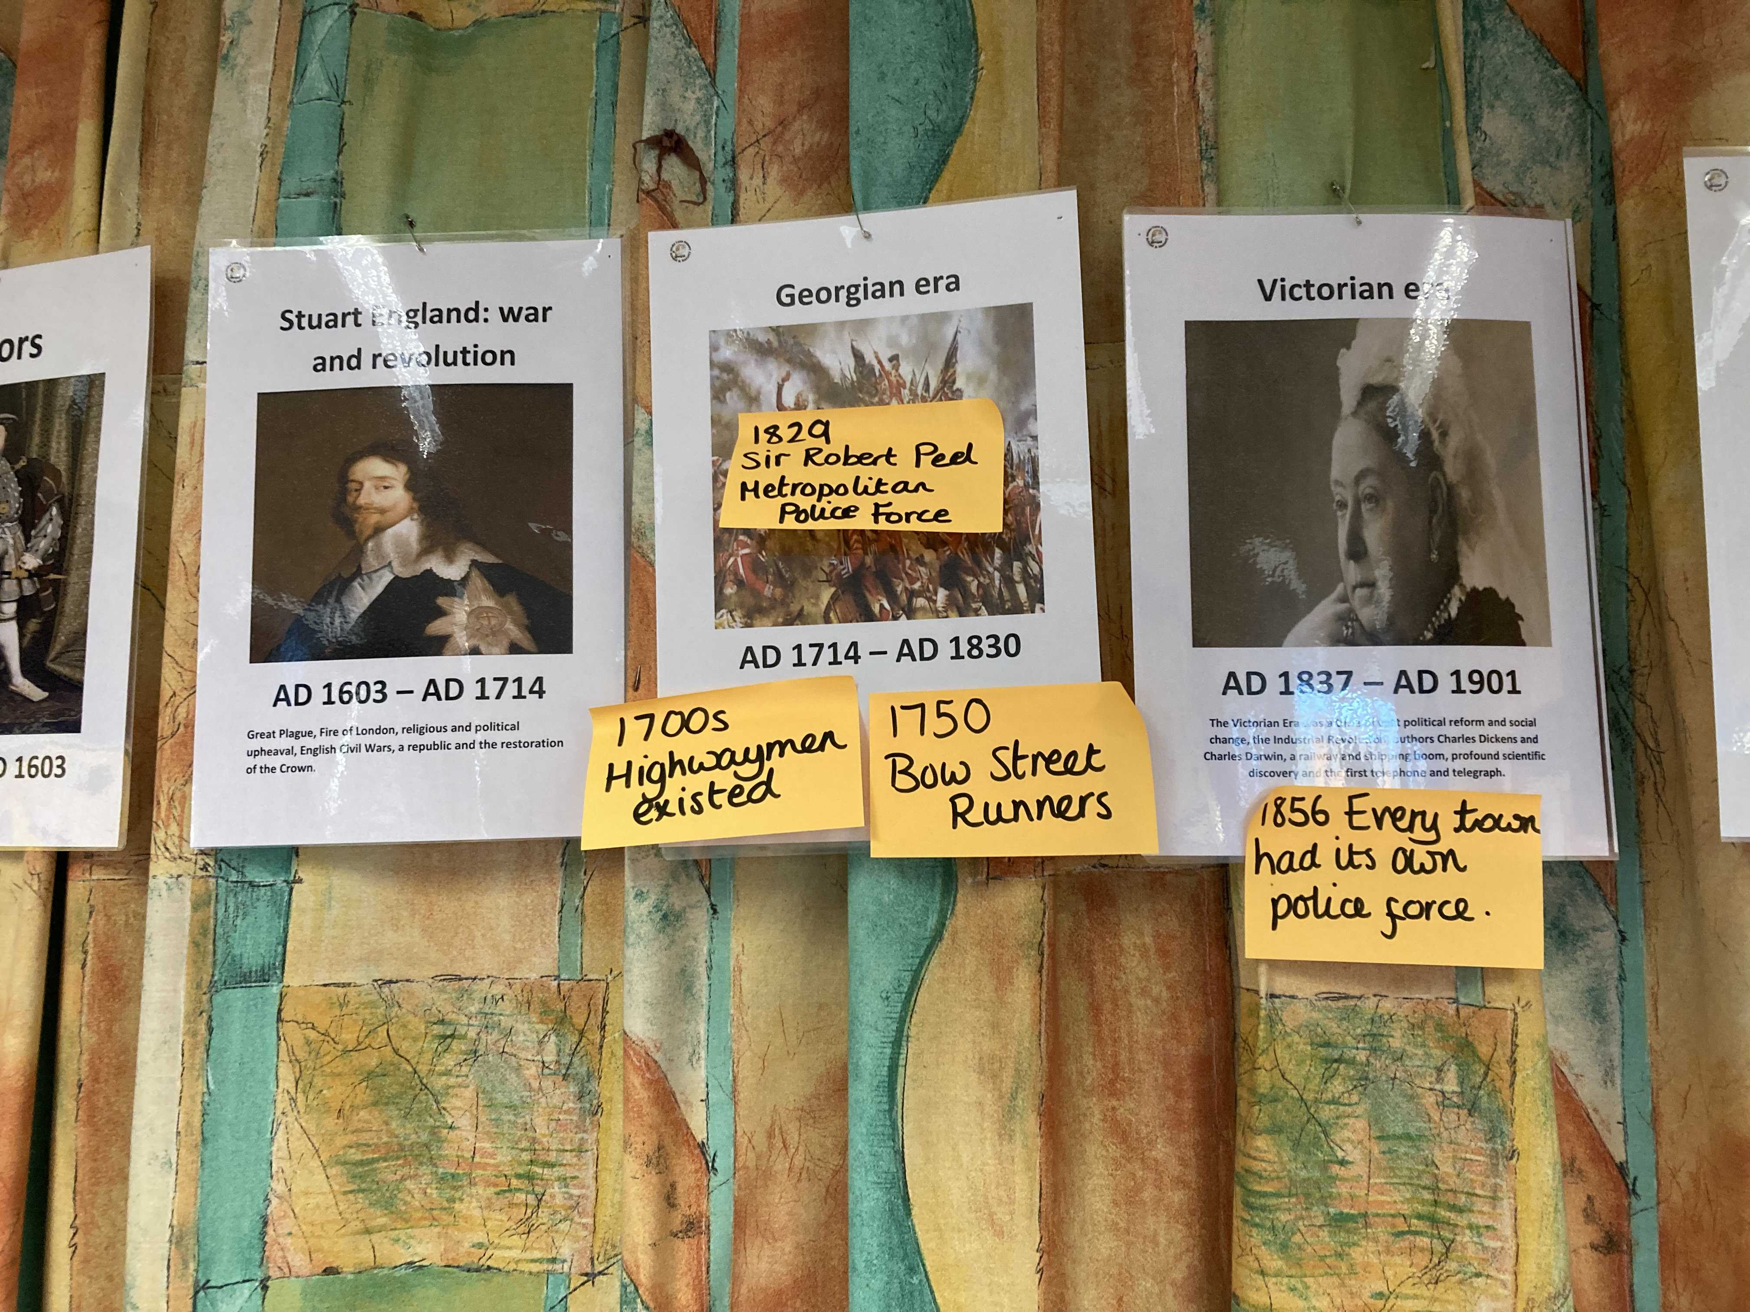
The timeline in Y6 which has been added to with key information, e.g. when the Metropolitan Police Force was established in 1829.

