Slide 1


End of KS2 SATs
Parents’ Information
Class Name: Owls
Teacher: Miss S Brough

Slide 2
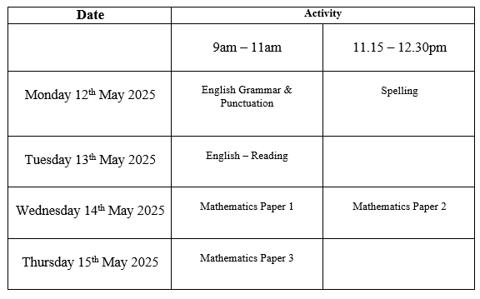
End of Key Stage 2 Assessments
Are timetabled from Monday 12th May 2025 to Thursday 15th May 2025.

Slide 3
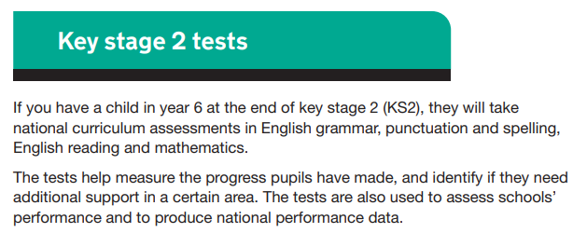
End of Key Stage 2 Assessments

Slide 4
Preparing for the assessments
Attend school regularly.
Read regularly at home (at least 3 times a week). This needs to be ongoing throughout the year.
Complete weekly homework tasks.
Practise for the weekly spelling tests.
Engage with Times Tables Rockstars.

Slide 5





SATs resources
How can I support my child at home?
Grammar:
https://www.youtube.com/playlist?list=PLbwwnj-Aki0MlZU8twWhT_zYMpdi4a0Cl
This link provides free access to songs to help with learning grammatical terms.
https://rollama.com/index-games-toggle.php
Here you can access some free grammar games. There is also an option for you to pay for a subscribed account if you wish which would open up more resources.
Maths:
Times Tables Rockstars https://ttrockstars.com/
We subscribe to this as a school and your child has their own log in for this.
Arithmetic practise: https://myminimaths.co.uk
The ‘resources’ section has some free resources called “miniMATHStasks” where they can practise key skills from the whole of the Key Stage 2 curriculum which they could be tested on.
Reading:
Reading at home 3 x a week can help with understanding vocabulary.
https://readtheory.org/ you can sign up to this for free and it will give your child comprehension questions matched to their ability.

Slide 6
Interventions and Boosters
In school interventions and after-school boosters are to “boost” your child’s score to give them the best opportunities to secure the expected standard.
All pupils will be offered additional opportunities to “boost” their scores either during the school day or as part of the after school boosters.

Slide 7
Any questions?
If you have any questions, please do not hesitate to ask me ☺

Slide 8
Thank you for attending.

