Slide 1
Our learning environment #7
February 2023

Slide 2
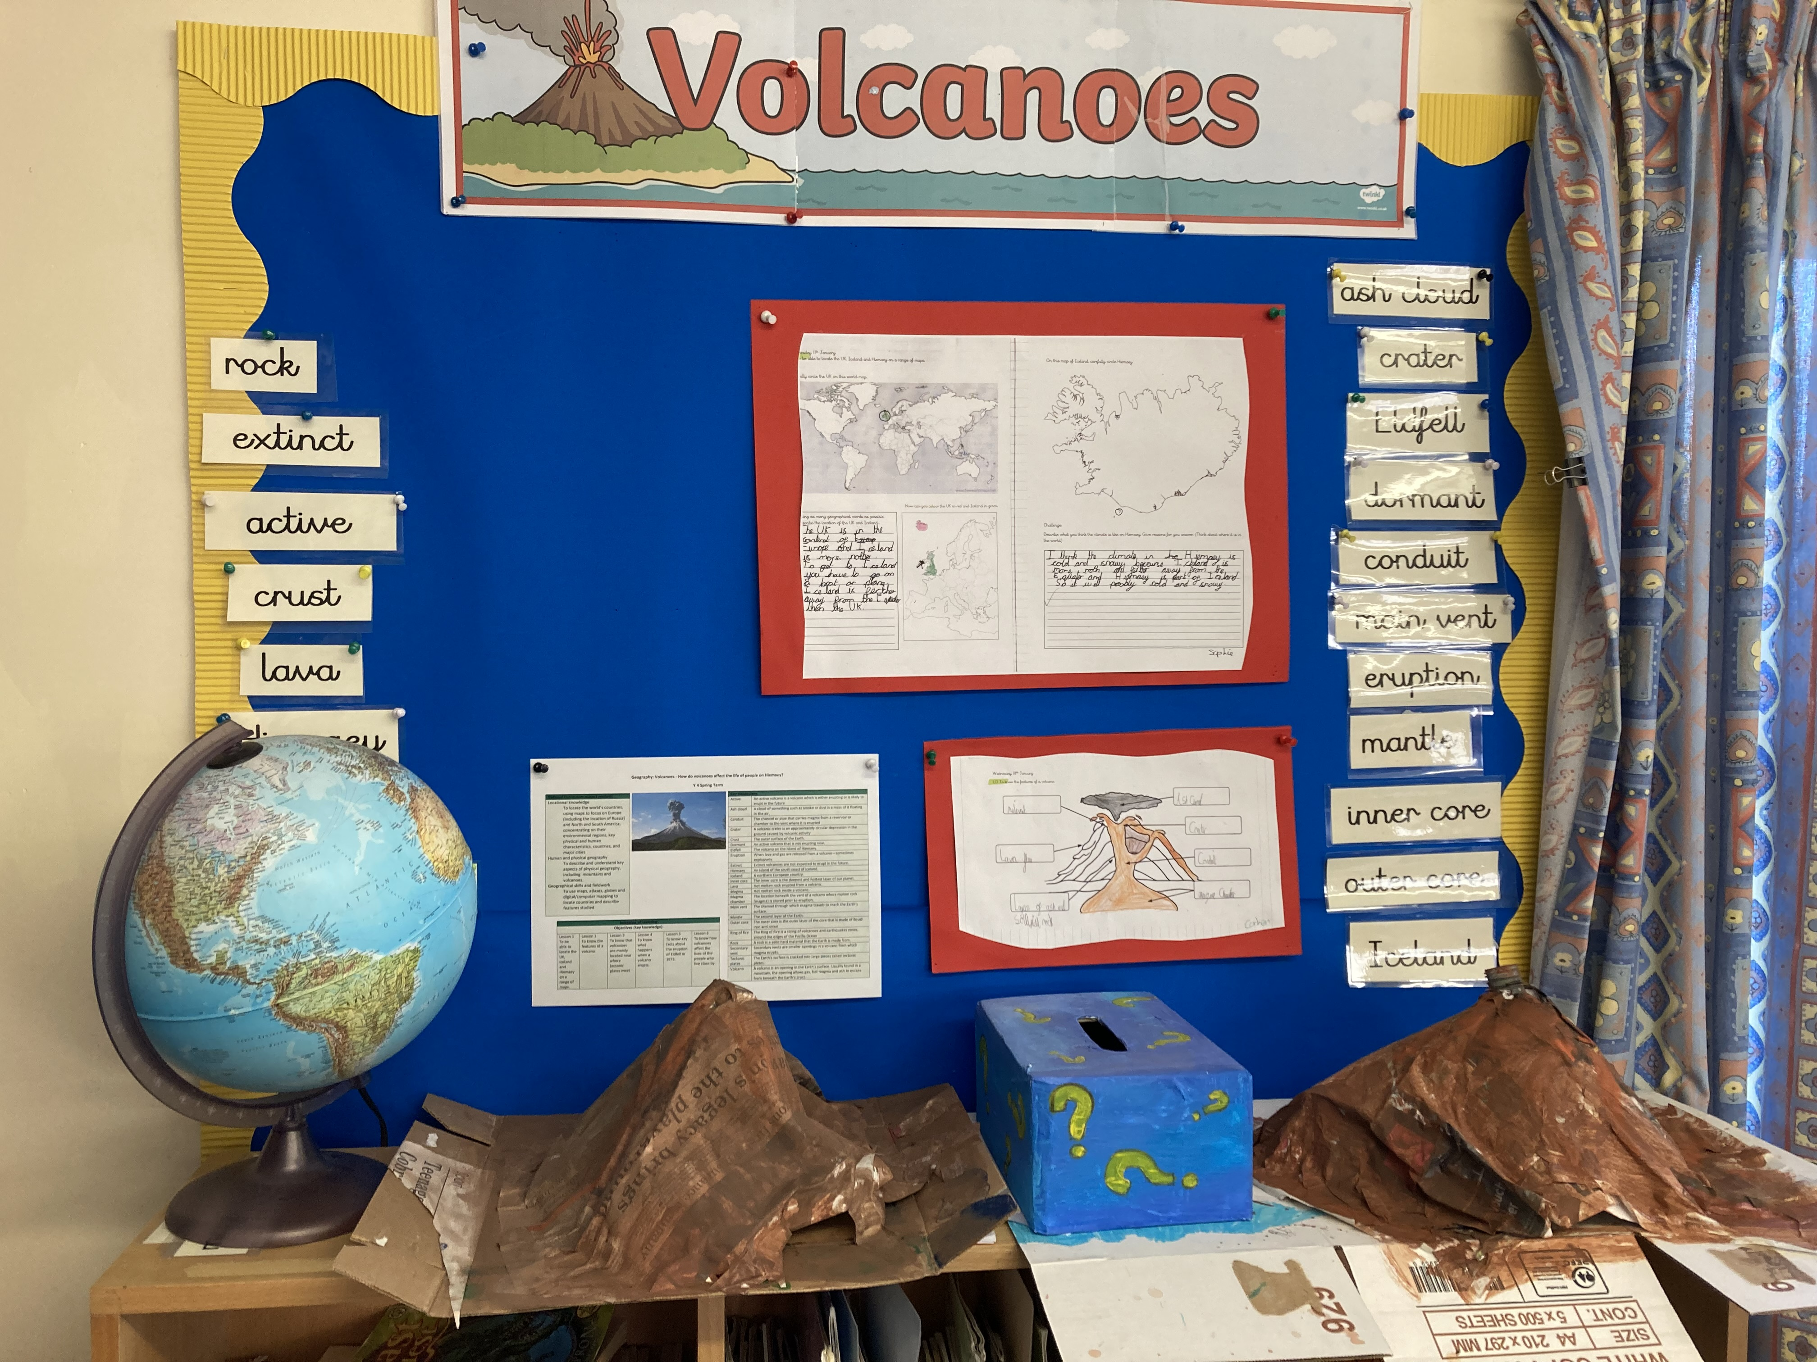
Y4 are studying volcanoes.
You can see all of the relevant vocabulary, the knowledge organiser showing the sequence of learning, and some pieces of high quality children’s work.
The children have also made their own volcanoes which are all ready to erupt. That’s the next exciting lesson!

Slide 3
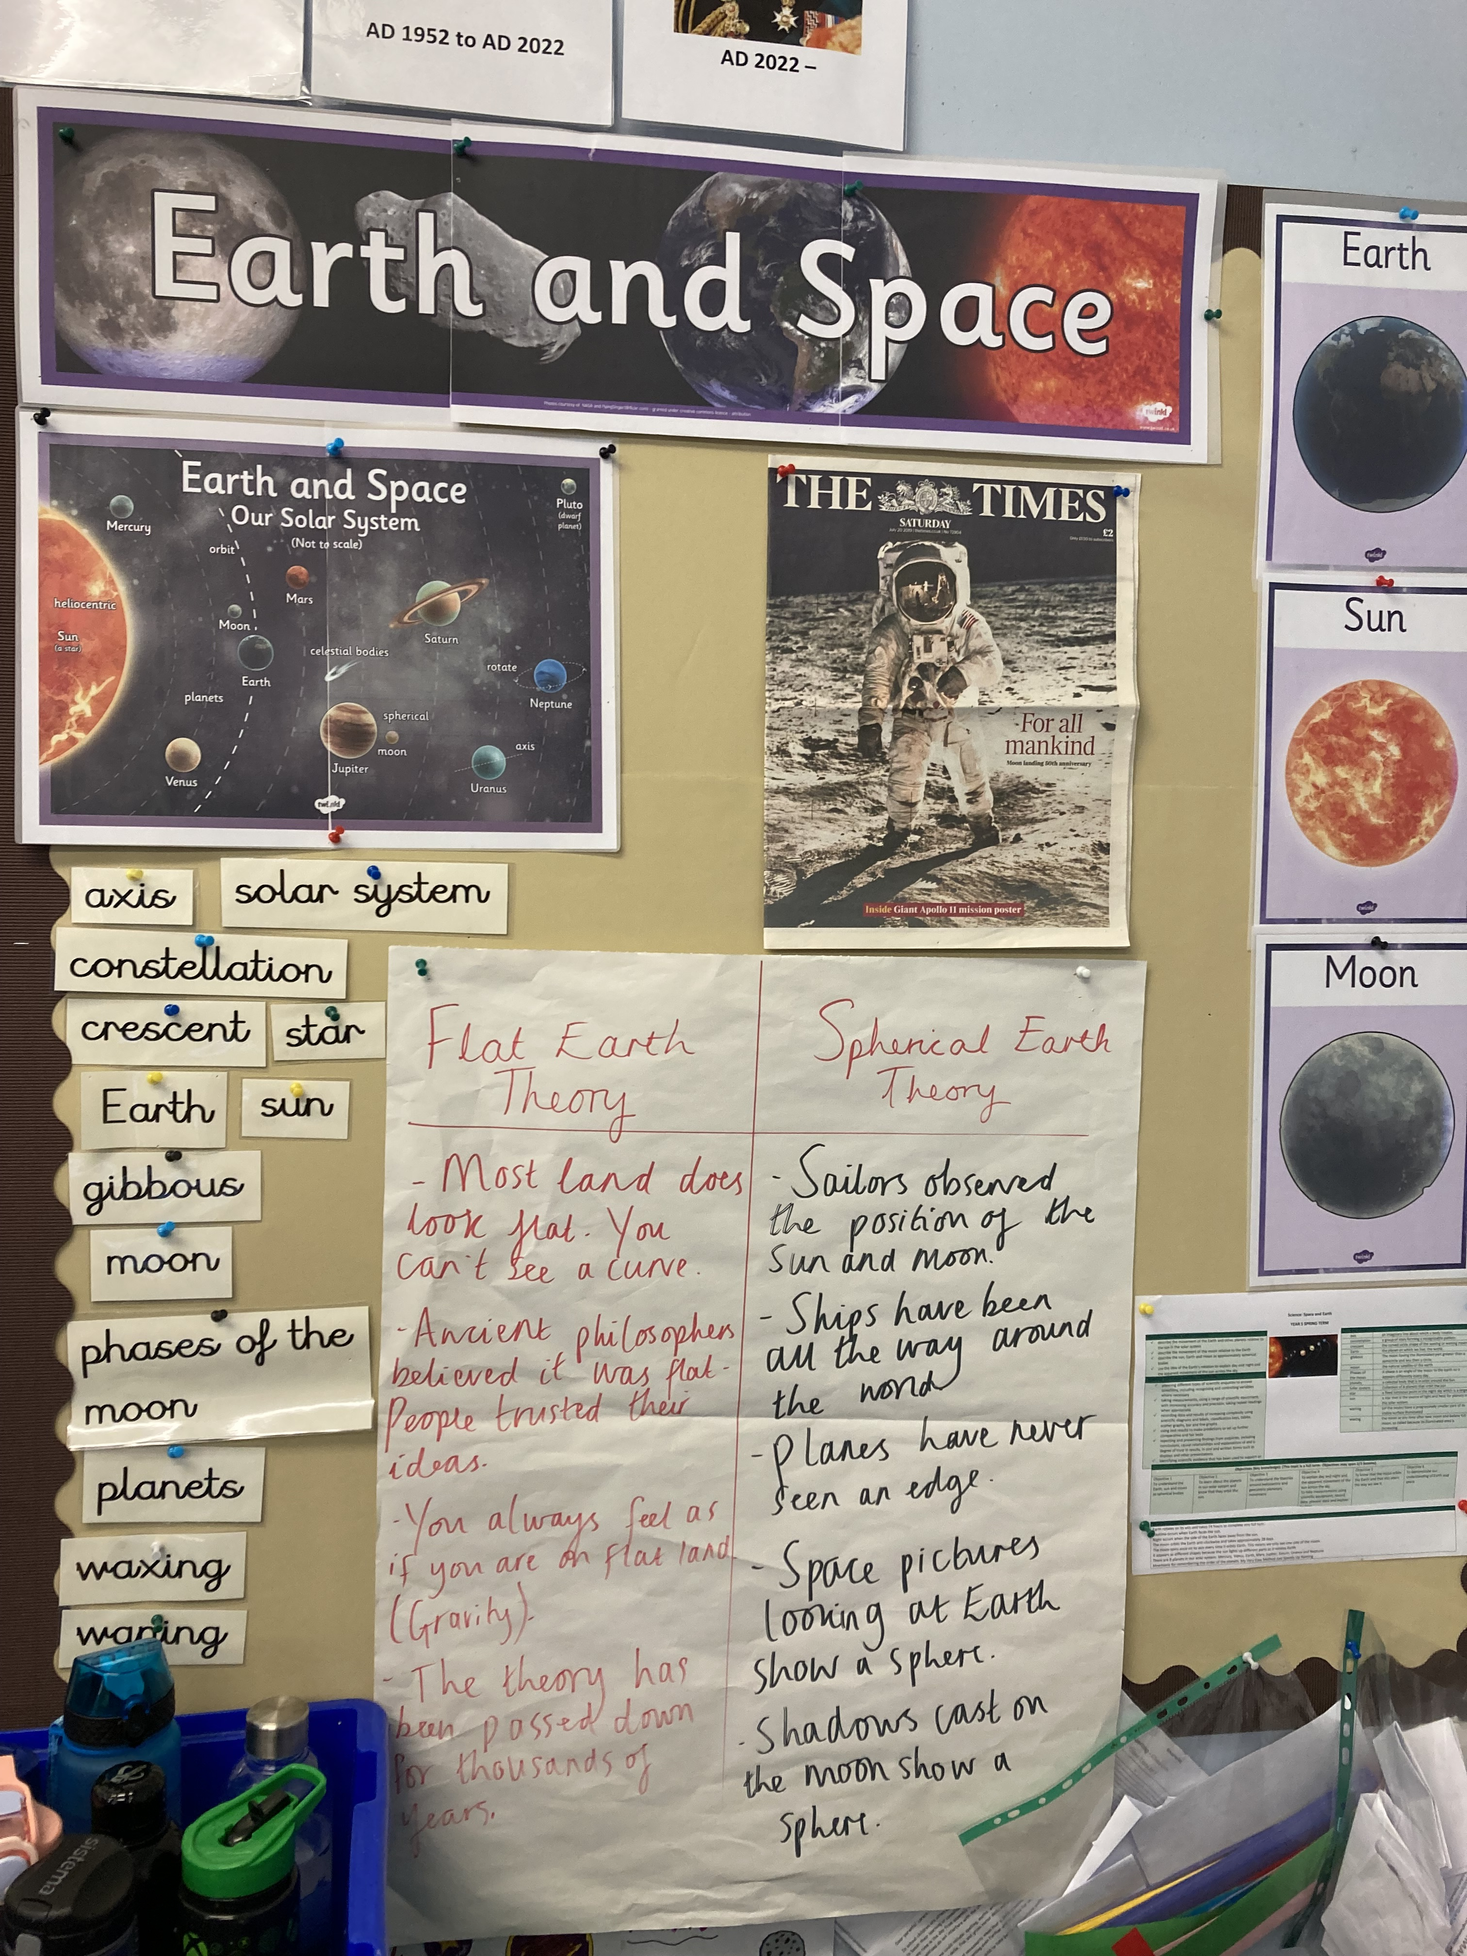
Y5’s earth and space topic looks so exciting!
Included is a newspaper front page and flip chart paper showing valuable discussions the class has had around the flat earth theory and the spherical earth theory.

Slide 4
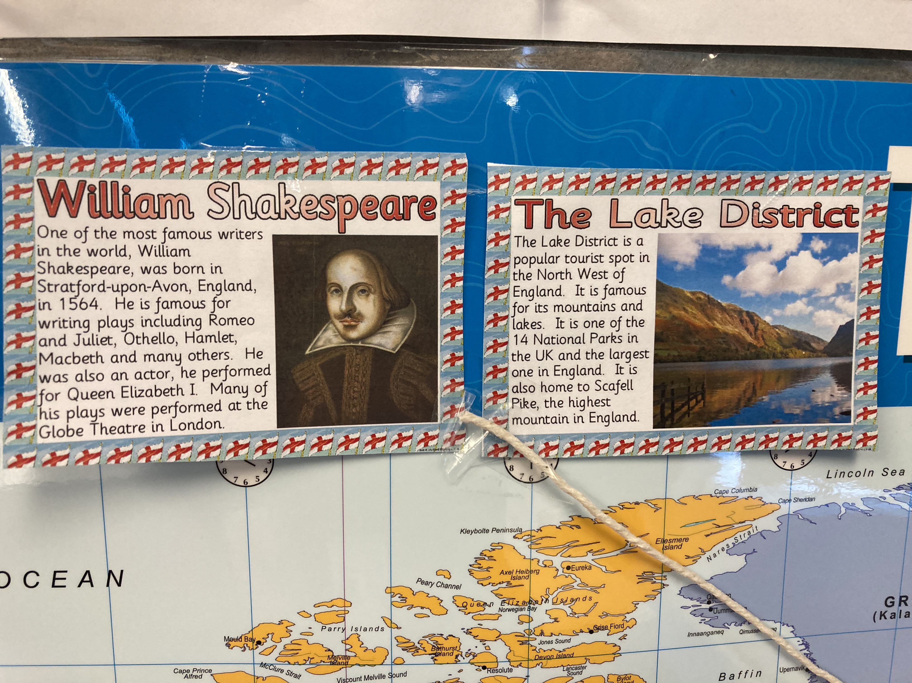
Knowledge maps are windows into information and they allow the children to explore the world.
Knowledge maps spark curiosity and provide insight.

Slide 5
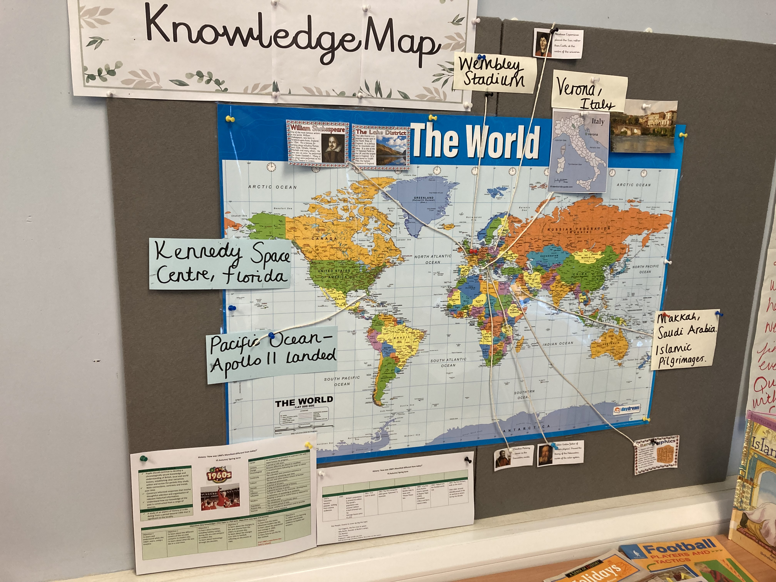
Y5’s information-rich knowledge map.

